Slide 1
AI and Auscultation
Kevin Machado-Gamboa
London, 5th February 2019
Notes:
Tonight I am going to talk about AI and Auscultation. I am going to share my participation throughout Python in a promising idea of innovation in the medical industry that could cause an improvement in the current process of auscultation by equipping the iconic medical tool with AI.

Slide 2
Content
Who I am
Background Information
The problem
Auscultation and the stethoscope
Heart sounds
World Technological Initiatives
My project: Development of algorithms to recognise normal heart sounds
using Python
Summary
Notes:
I am going to start by introducing myself and how I got involved in this project. World initiatives which is how other people and institutions have been contributing

Slide 3
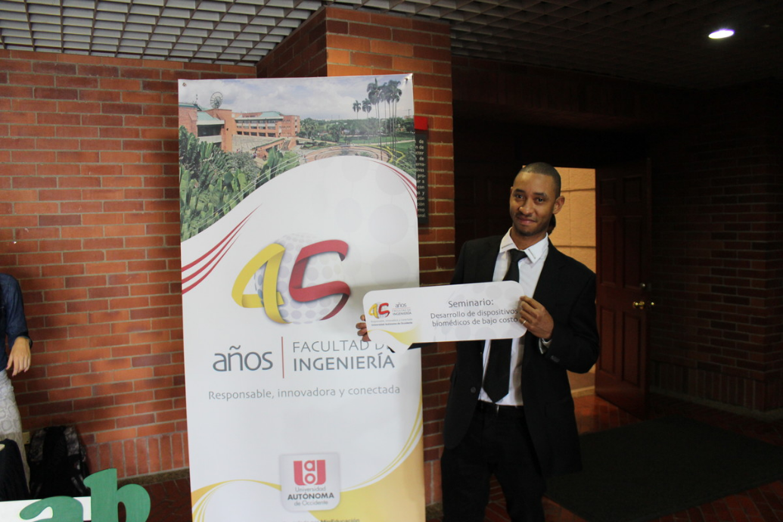
Who I am
I am from Cali, Colombia
Notes:
I’m from Cali, please do not think about Cali-Cartel because since years Cali has been a nice city a nice city located in the south west of Colombia.

Slide 4
Who I am
Biomedical engineer from Universidad Autonoma de Occidente
UI GreenMetric World University Ranking: The most self-sustainable university in Colombia and the third in Latin America
Notes:
I am a Biomedical Engineering graduate from UAO. In Biomedical engineering we learn from medicine and engineering principles to find solutions in health-care problems

Slide 5
The team
Notes:
After finishing my undergraduate studies I wanted to work with a great group of people on real healt problems

Slide 6
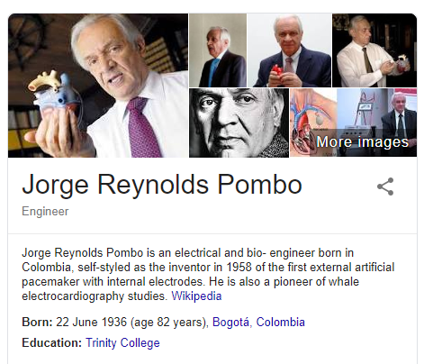
A Great Team
Voluntary research assistant in Cardiovascular Medicine and Specialties of High Complexity research group
Development of algorithms to recognise normal heart sounds
Notes:
I’ve been working as a volunteer locally in Bogota, and now remotely because I moved to the UK …. Directed by Jorge Reynolds Pombo. Colombian pioneer in the development of pacemaker technology.
With him, I’ve been working in research to develop algorithms in python to analyse and recognise heart sounds.
Why do we want to do that.
How can we define a normal sound by computer? How are we going to show this information to doctors?
Trained doctor are able to achieve this task by hearing

Slide 7
What’s the problem behind this research?
Notes:
Why are we working on

Slide 8
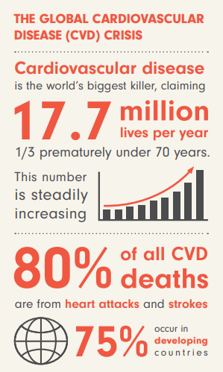
Cardiovascular disease (CVD)
Leading global cause of death
In Colombia, 29% of all deaths corresponds to CVD (Instituto Nacional de Salud 2011)
In UK, 26% of all deaths correspond to CVD (British Heart Foundation)
In 2012, an estimated 17.5 million people died from CVDs. By 2030, CVDs are projected to cause 22 million deaths a year
Ref: American Heart Association Statistics 2017
WHO Cardiovascular diseases (CVDs). Fact sheet Updated May 2017 (http://www.who.int/mediacentre/factsheets/fs317/en/)
Notes:
Cardiovascular disease (CVD) is a group of diseases that involve the heart or blood vessels. According with WHO and other international institutions CVD’s are the leading global cause of death. In Col .. In the UK, according with BHF is around 26% of all deaths. And the most alarming things is that By 2030 …
Now, how do we strength primary health care systems to reduce heart attacks and strokes?

Slide 9
Auscultation and the
Stethoscope
Notes:
One way could be innovating Auscultation Process and the Stethoscope

Slide 10
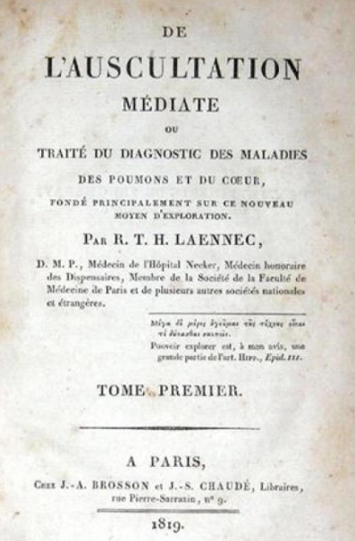
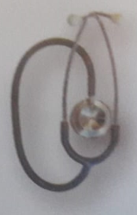
Auscultation
The action of listening to sounds inside the human body
Hippocrates 5 B.C.
Normally with a stethoscope
Notes:
Auscultation is the action or the technique to listen to the sound inside the body. This include, cardiac sound (the heart) and other organs. This practice has been reported since the fifth century BC but Since decades ago auscultation is performed by the stethoscope. But the stethoscope has not always been as it is .. Let’s have a look of it

Slide 11
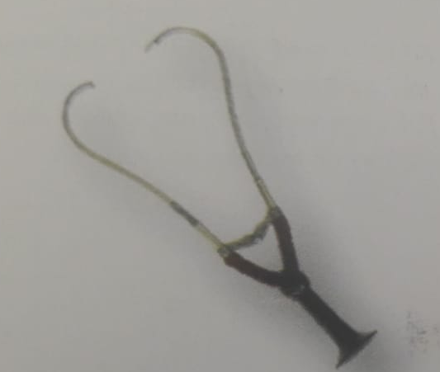
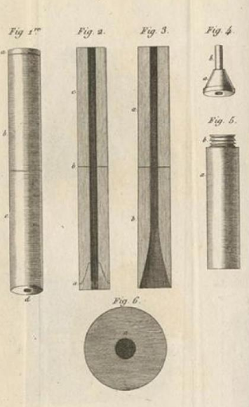
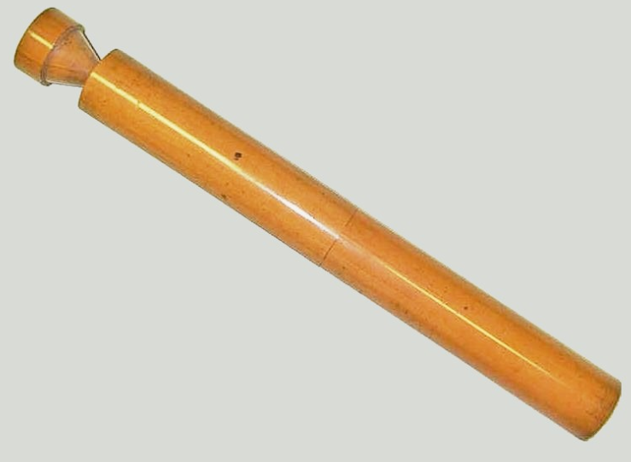
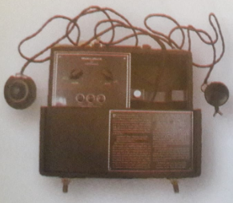
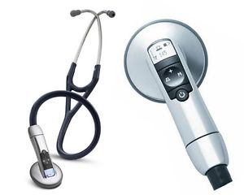
The Stethoscope
Dr. George Cammann 1852
Dr Littmann 1961
Rene Laënnec 1819
Western Electric 1925
New Littmann
Notes:
This was the original version of Laënnec stethoscope in 1819 made of wood. Monaural or with the capacity to listen with one ear or the other. Years later the first commercial binaural stethoscope appear to enable Dr’s listen with both ears.
Almost 1 century later western electric release the first electronic stethoscope, Dr’s where able to control the HS volume and apply analogue filters.
Years later the classic littmann was introduced by Dr. Littmann. The stethoscope continues to be innovated I both hardware and software. We can find

Slide 12
World Technological Initiatives
Notes:
Now, What people around the world, researchers and institutions are developing in technology, with AI

Slide 13
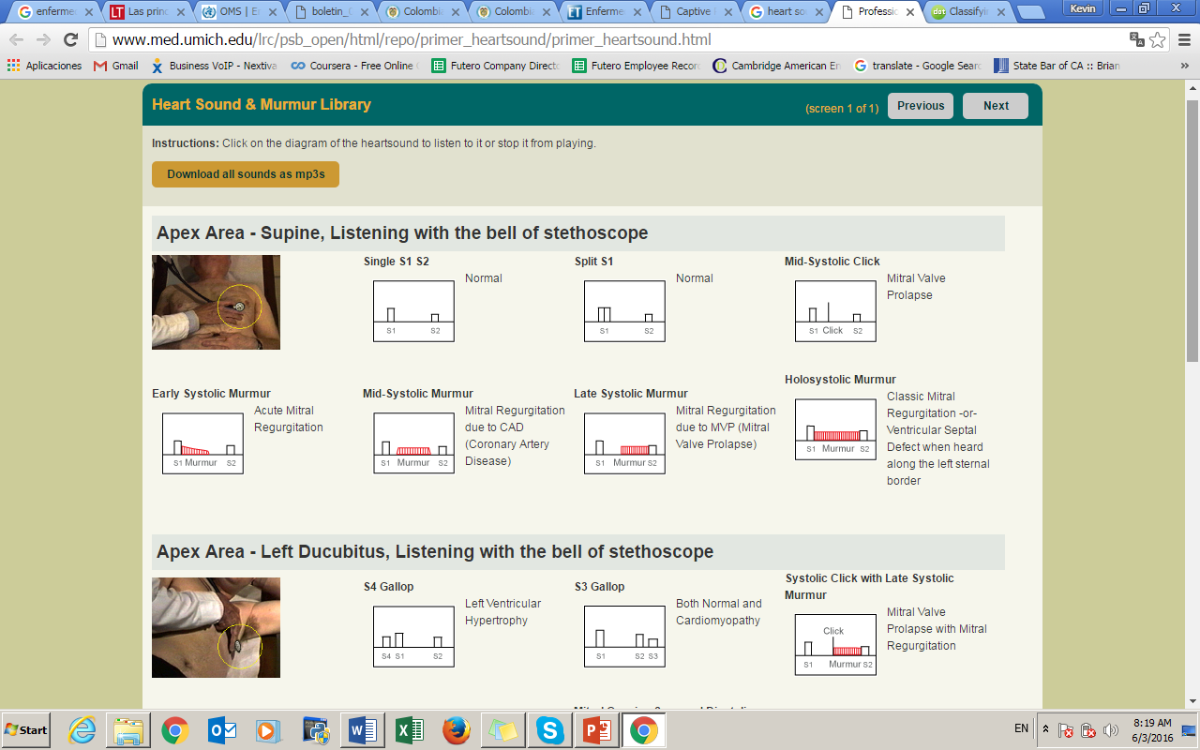
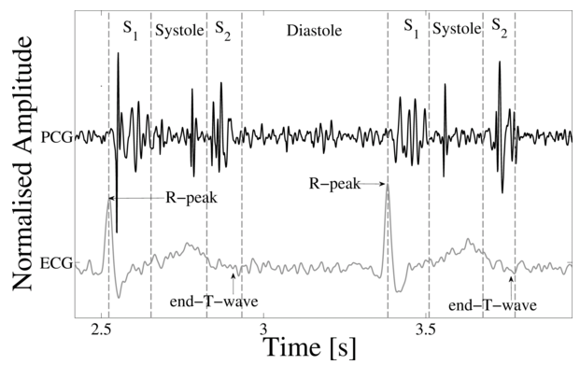
Global Efforts
PHYSIONET
Classification of normal/abnormal heart sound recordings: The PHYSIONET/Computing in Cardiology Challenge 2016
https://www.physionet.org/challenge/2016/
http://www.med.umich.edu/lrc/psb_open/html/repo/primer_heartsound/primer_heartsound.html
Notes:
Because for people who are not able to have access to HS recordings from real patients, There are some public databases available and that is very important. One of those I really like is provided by Physionet (offers free web access to large collections of recorded physiologic signals). 9 independent HS databases provided by different RS around the world. With more than 4k recordings from healthy and unhealthy patients .. People used to train their models

Slide 14
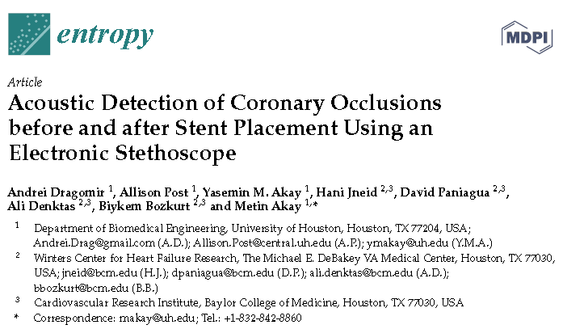
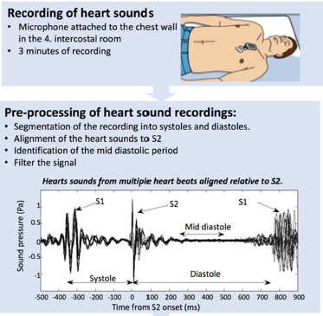
Global Efforts
Dragomir A. Acoustic Detection of Coronary Occlusions before and after Stent Placement Using an Electronic Stethoscope. Entropy 2016, 18, 281; doi:10.3390/e18080281
Notes:
Researchers in H Texas Using an electronic stethoscope and some techniques in time and freq domain, they investigated the acoustic signature of CAD in subjects with a single coronary occlusion before and after stent placement. They assessed differences induced by the stent placement procedure to the acoustic signature signals in time domain. They conclude: Our approach demonstrated that the effect of stent placement on coronary occlusion can be monitored using an electronic stethoscope. Something similar had happened in Denmark .. quote: Sound-based detection of CAD enables risk stratification superior to clinical risk scores. This new acoustic system could potentially supplement clinical assessment to guide decision on the need for further diagnostic investigations.

Slide 15
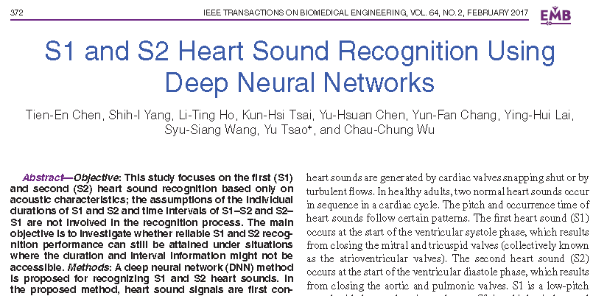
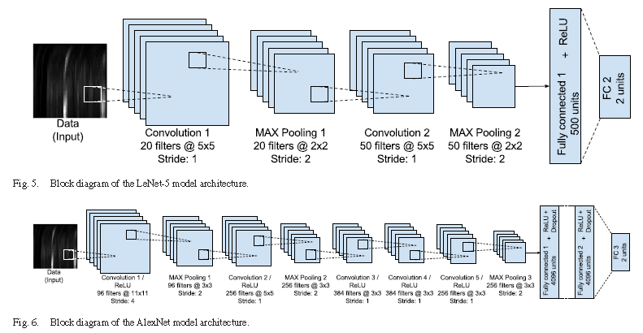
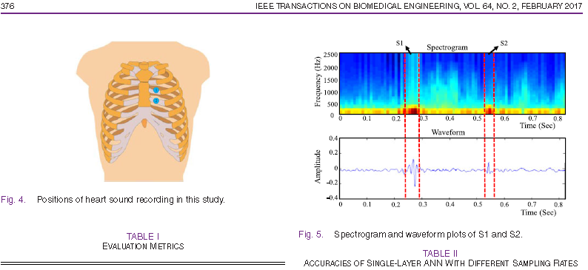
Global Efforts
Notes:
People is using DNN
S1 and S2 Heart Sound Recognition is essential for doctors if they want to analyse what is happening with the heart. S1 and S2 defines … respectively. And people have proved with DNN how to do this, just based on the acoustic characteristics. Many people also develop transformations from time-domain to time Frequency or Mel coefficients, getting an image to then apply image recognition or vision recognition techniques.

Slide 16
The heart sound
Notes:
One way could be innovating Auscultation Process and the Stethoscope

Slide 17
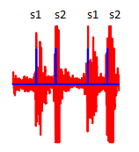
Heart Sound
Notes:
In a normal heart sound we will have two different sounds. We called s1 and s2. Doctors in order to make diagnosis through auscultation, they need to find abnormalities between segments s1 and s2, and s2 and s1

Slide 18
Development of algorithms to recognise normal heart sounds using Python

Slide 19
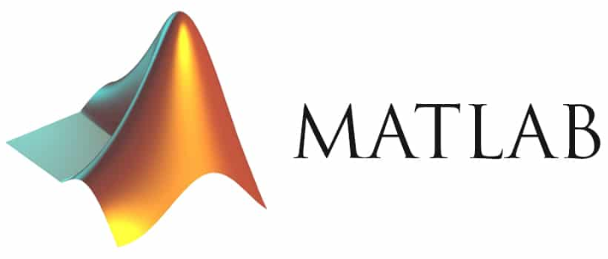
From one programming language to another
Python 2 or Python 3
Libraries
Numpy
Matplotlib
ScyPy
All easy, all included

Slide 20
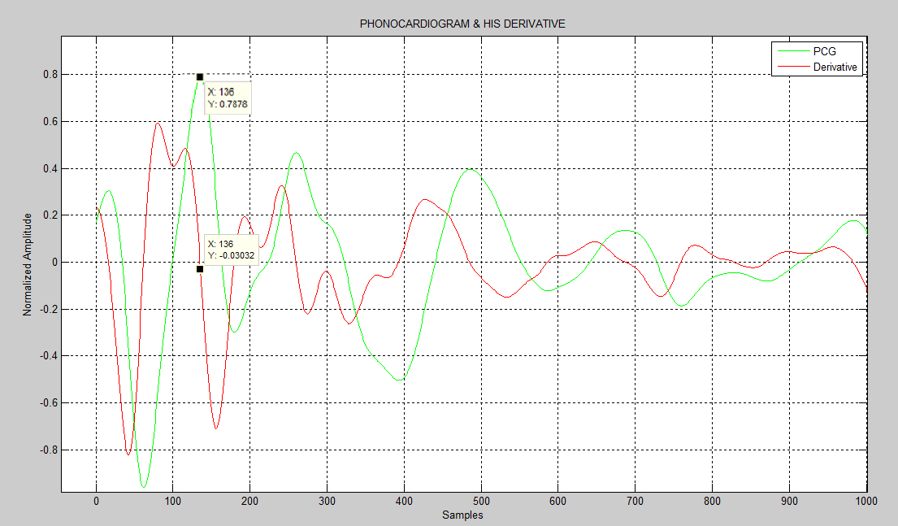
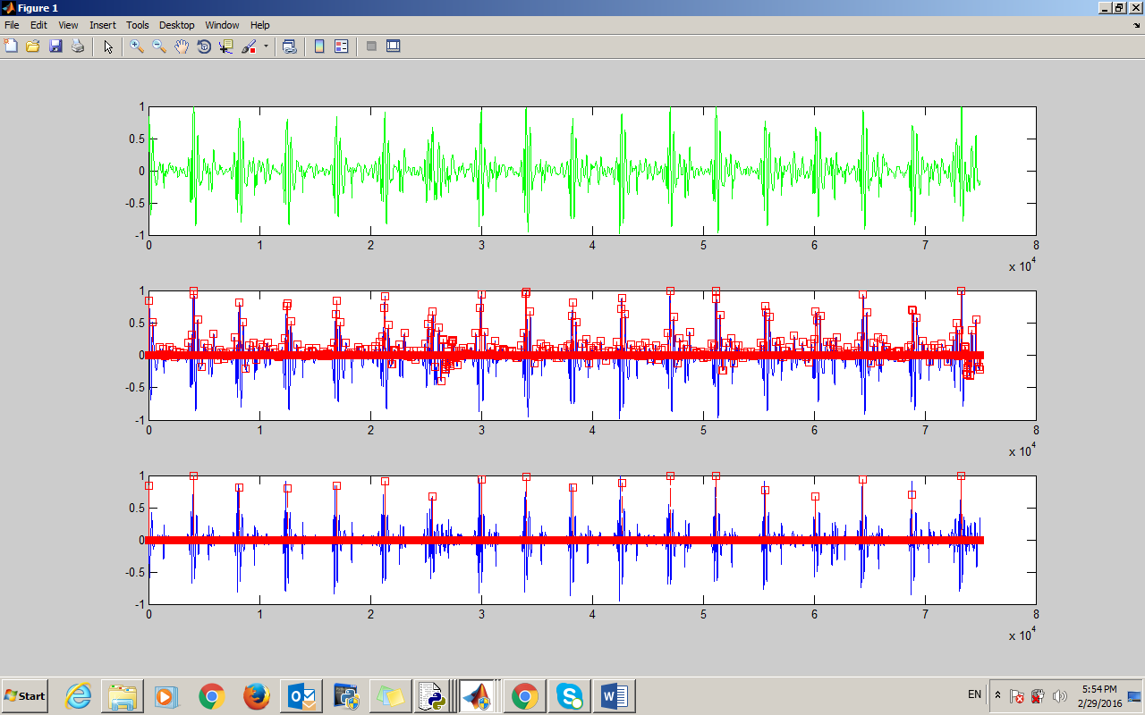
Heart Sound Segmentation
Notes:
One of the 1st steps in order to analyse HR signals is to identify the segments s1 and s2. We have developed an algorithm base on the signal time-amplitude parameter of the signal

Slide 21
Signal Processing Techniques
Low Frequencies
Medium Frequencies
High Frequencies
Filtering Techniques
Fast Fourier Transform (FFT)
Spectrogram
Notes:
We have been applied signal processing techniques in Python to developed digital filters to analysed the signal information in different bands, low, medium and high frequencies. This allow us to extract information to classify different pathologies. We are also using the FFT in order to identify the frequency components in the whole signal and each of its segments. We are also using the spectrogram to analyse how the freq content varies with time.

Slide 22
Non-Pathological Heart Sound
Normal phonocardiogram from the PhysioNet/Computing in Cardiology Challenge 2016 https://www.physionet.org/challenge/2016/
Notes:
Here is an animation of a non-pathological heart sound in Python. In the graph above we have the spectrogram of the signal (Freq, over Time) and below the phonogram (amplitude over time) – let’s listen to this normal heart sound. If we see for example the graph below we can see a normal distribution of the segments between s1 and s2.

Slide 23
Pathological Heart Sound
Pathological phonocardiogram from the PhysioNet/Computing in Cardiology Challenge 2016 https://www.physionet.org/challenge/2016/
Notes:
If we see the two graphs it changes considerably. Let’s listen to the pathological heart sound.
In this pathological heart sound, we can see first a different colour distribution which means there is something abnormal. We can also observe abnormalities in the graph below, between S1 and S2. (play sound) – can you notice the difference? It’s not that easy right?!

Slide 24
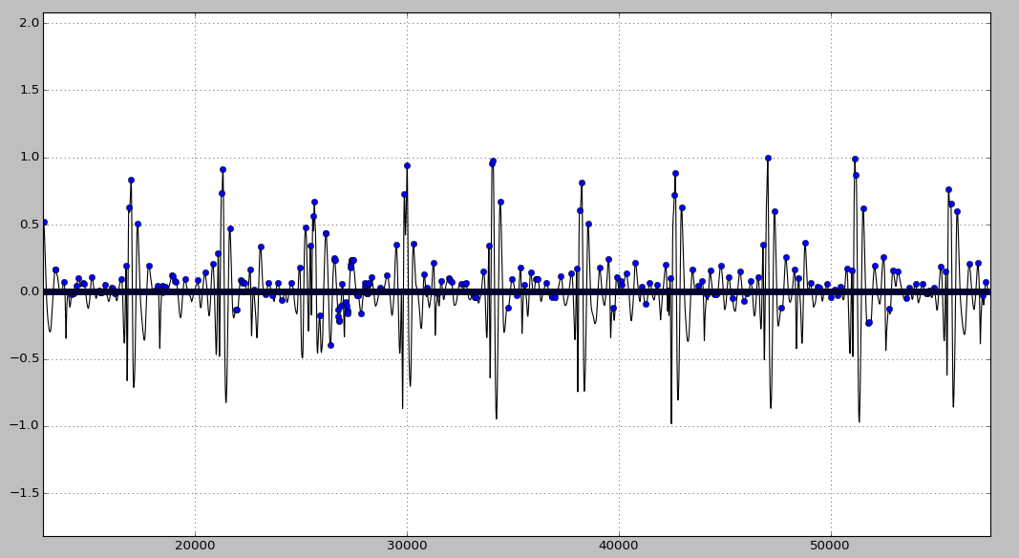
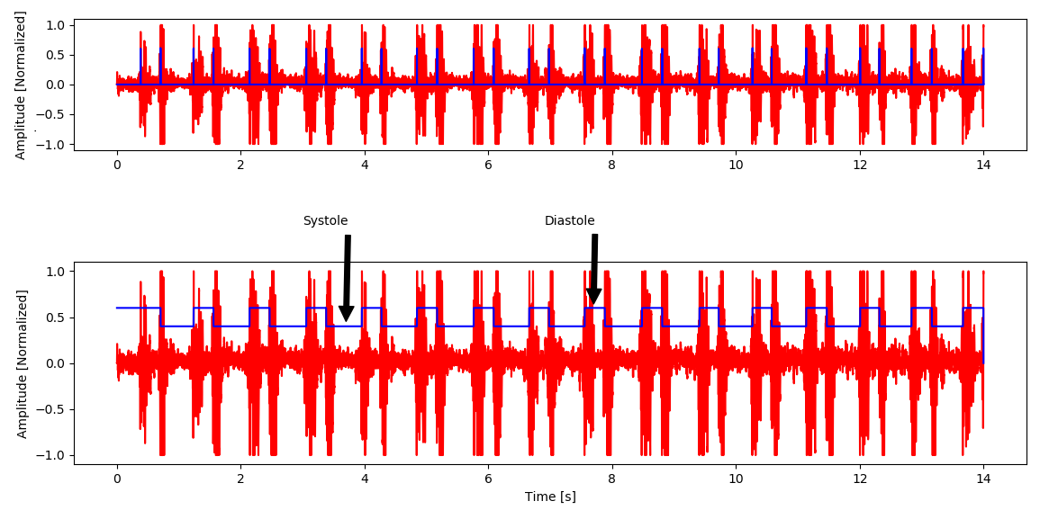
Biologically Inspired Algorithm
Naka-rushton function
Notes:
Also in Python, I am developing biologically inspire algorithms .. I can’t mention more than that for now but we will be publishing our results.

Slide 25
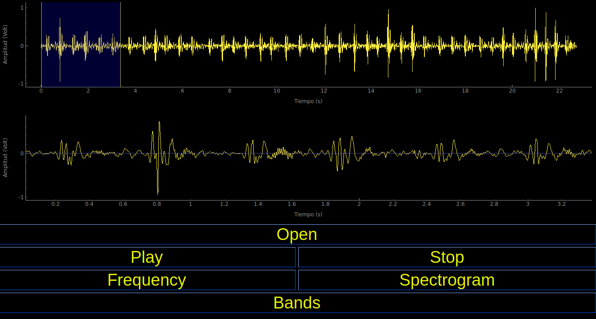
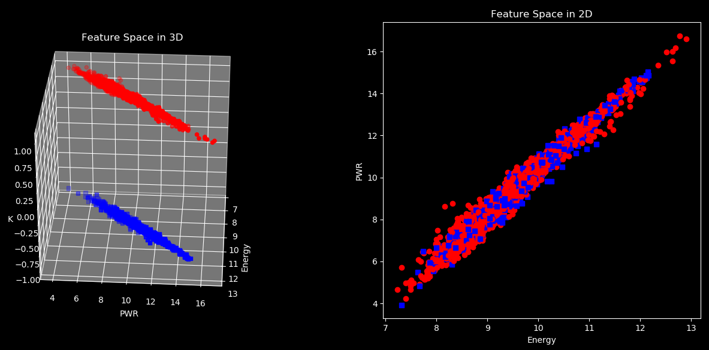
Software Prototype

Slide 26
Summary
AI and auscultation
Normal heart sound signature
Doctor-Computer interaction
Notes:
In summary, I have shown you how I have used Python to create algorithms to detect normal heart sounds. The next step is to detect and classify abnormal heart sounds. I have shown you the history of the stethoscope and I believe that it will continue to develop with these new technological advances. You have seen how we are also visualising heart sounds and this could also aid doctors in the future.

Slide 27
https://github.com/LatinAmericanProgramer/Phonocardiogram_Processing
Notes:
In summary, I have shown you how I have used Python to create algorithms to detect normal heart sounds. The next step is to detect and classify abnormal heart sounds. I have shown you the history of the stethoscope and I believe that it will continue to develop with these new technological advances. You have seen how we are also visualising heart sounds and this could also aid doctors in the future.

Slide 28
Contact details
Linkedin - https://www.linkedin.com/in/kevin-machado-gamboa-b958b6167/
Github - https://github.com/LatinAmericanProgramer
Email: ing.kevin@hotmail.com
Mobile: 07378 313 496
Thank you

