Slide 1

NEST
Nurturing Excellence,
Strengthening Talent.
ABSTRACT SUBMISSION
GUIDELINES

Slide 2
Problem Statement – #2nd Problem Statement
Predicting actual enrolment duration for clinical studies with explainability

Slide 3
Approach & methodology
Overview
Methodology
Framework / tools used
There is 450,000 clinical trial data, which contain 22 columns most of the column carries text data, while some columns (Sex, Age, Phases, Enrollment) carry data which can be label encoded into numerical format.
Some columns do not have any relation with the target variable(i.e Time taken for Enrollment), remove them from dataset
In short have to predict the Time taken for Enrollment for a specific clinical trial with given data using Natural language processing(NLP)
Raw clinical Text > Preprocessing (Removing common words, Normalization, spell Correction, Lemmatization) > Embedding >Segmentation > NER > SRL> WSD > Relationship Extraction > Feature Extraction > Model Training > Accuracy
The dataset is given since the embedding generation takes much time; you have to take a 1000-row dataset, 5 times, and train it on that to get an overall accuracy; only those rows that have all the rows complete are taken.
Pre-processing - Removing Common words (is, the, etc) > spell correction > making synonym words the same > Lemmatization
Model – Bio-Bert + Clinical Bert) to generate embedding > RNN + BiLSTM for model training
Variables - Study Title, Brief Summary, Condition, Study Design, Study Document, Study Status, Study Results, Intervention, Sex, Age, Phase
Use RMSE score, R2, and adjusted R2 score (as the target variable is in numerical format)
Input – Pandas (Handling and loading structured data)
Stop word Removal – NLTK (Text Cleaning)
Text Cleaning – re/regex (punctuation removal)
Synonym Expansion – NLTK WordNet
Label Encoding – Scikit-learn (Converting categorical data into format)
Embedding Generation – Transformers(Hugging Face) (pre-trained models Clinical Bert/Bio Bert for domain-specific embedding)
Named Entity Recognition – SciSpacy (domain specific)
Semantic Role Labeling – AllenNLP
Word Sense Disambiguation – BioBert
Relationship Extraction – Stanza
Model Training – PyTorch (for RNN and BiLSTM Model)

Slide 4
Model choice & setup
Model Selection
Model Architecture
Clinical BERT / Bio BERT: Domain-specific pre-trained transformers provide embeddings tailored for biomedical and clinical text, ensuring high relevance and accuracy.
Named Entity Recognition (NER): SciSpacy leverages domain-specific models for extracting biomedical entities like diseases, drugs, and symptoms, crucial for downstream tasks
Semantic Role Labeling (SRL): AllenNLP enhances understanding by identifying the roles of phrases in sentences, such as agents, actions, and objects.
Word Sense Disambiguation (WSD): BioBERT ensures accurate interpretation of biomedical terms that may have multiple meanings.
Relationship Extraction: Stanza identifies connections between entities, enabling insights like cause-effect or drug-disease associations.
Extract 5 sets of 1000 rows of data from the actual dataset, which do not contain any missing values for feature variables (shortened data for faster embedding processing).
Removing the unwanted columns, only features variable columns are sustained using Pandas.
Data Preprocessing – Raw text is first converted to lowercase, with punctuation removal (using NLTK) and synonym expansion. “Cleaned text” is used for named entity recognition, which is stored as a new column; this is used in relationship extraction (Stanza). Parallelly, “cleaned text” goes for semantic role labeling, which is stored in a new column. Entities from NER and cleaned text go through word sense disambiguation (WSD). Entities from NER, WSD, and SRL are used for relationship extraction using Stanza.
Labelling category data
Embedding Generation - Cleaned text + entities + semantic roles + disambiguated words (for each feature column, excluding the category column) are used as input, and BioBERT is used to generate embeddings for these processed columns.
Dimensionality reduction— embedding is reduced using UMAP.
Model Building – UMAP Embeddings are used as input features for the BiLSTM and RNN models to predict the time taken for the enrolment column as the target variable.
Checking accuracy for the BiLSTM and RNN models using RMSE, R², and adjusted R²

Slide 5
Model Training & Evaluation
Evaluation Metrics
Model Training Process- UMAP embedding > Dataset divided into 80:20 ratio for taring and testing respectively. > Integrating labeling category column and UMAP embedding (generated of text data) > Putting in BiLSTM/RNN layer with 64 units and relu activation > Dropout rate of 0.2/ 03 (for RNN) > Adam optimizer > Train with batch size of 32 > epochs = 50
Evaluation Criteria and Metrics – Root Mean Square Error (RMSE), R-squared score, Adjusted R-squared score, Symmetric Mean Absolute Percent Error (SMAPE)
Discuss key performance metrics - BiLSTM
RNN
RMSE | R-Squared | Adjusted R-Squaed score | SMAPE
5.37130 | 0.016 | 0.9834 | 54.3774%
RMSE | R-Squared | Adjusted R-Squaed score | SMAPE
5.1650 | 0.027 | 0.9987 | 60.730%

Slide 6
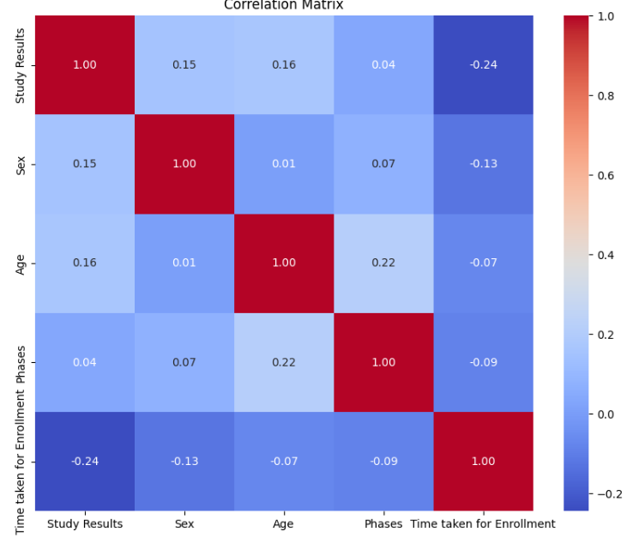
Results and visualization
Model Outcomes
Explainability
Columns like NCT Number, Study URL, Acronym, Other Outcome Measures Sponsor, Collaborators, Funder Type, Study Type, Study Design, Other IDs, and Locations donot have any effect on the Time taken for enrollment and removing these help in improving the accuracy of the model
Age and Phases have the minimum correlation with the target variable if compared to other label category column
SMAPE Analysis: BiLSTM outperforms RNN with a lower SMAPE (54.38% vs. 60.73%), indicating better generalization
RMSE Comparison: RNN has a slightly lower RMSE (5.1650 vs. 5.3713), suggesting better accuracy in some predictions.
R² Values: Both models have low R² scores, showing limited ability to explain data variance.
Improvement Scope: Error patterns highlight the need to refine input features to improve model performance.

Slide 7
Challenges & Next Steps
.
Limitations
Next Steps
Domain-Specific Data Dependency: Pre-trained models like Clinical BERT/BioBERT may not generalize well to out-of-domain datasets
Limited Feature Interpretability: BiLSTM and RNN are black-box models, making it challenging to interpret how specific features influence predictions.
Class Imbalance: Potential biases may arise if certain classes or categories in the dataset are underrepresented.
Static Embeddings: Pre-trained embeddings may not fully capture nuances or recent developments in clinical language.
Overfitting Risk: Complex architectures like BiLSTM and RNN are prone to overfitting with small or noisy datasets.
Low R² Values: The low R² indicates the models may not fully capture relationships in the data, limiting reliability.
Data Augmentation: Enhance dataset quality by adding more labeled samples or using data augmentation techniques.
Hyperparameter Tuning: Conduct extensive grid search or Bayesian optimization to improve model performance.
Feature Engineering: Incorporate additional domain-specific features or leverage external clinical datasets
Explainability Tools: Use SHAP or LIME to better interpret model predictions and improve trust in the results.
Ensemble Models: Combine BiLSTM, RNN, and transformer-based models for robust predictions.
Domain Adaptation: Fine-tune pre-trained models like BioBERT on the specific dataset to improve embeddings.
Bias Mitigation: Address class imbalances through re-sampling or weighted loss functions.

Slide 8
General guidelines
Do's:
Be clear and concise: Ensure each slide is easy to understand and free of unnecessary jargon
Use visuals: Incorporate visuals to make the data and results more accessible
Emphasize key points: Highlight the most important aspects of your approach and findings
Highlight Limitation: Clearly state any limitations or challenges faced during the project
Don'ts:
Overload slides: Avoid cluttering slides with too much text or too many details
Ignore explainability: Ensure you address how the model's decisions can be interpreted
Skip data details: Provide enough information about data sources and preprocessing steps
Neglect metrics: Clearly define and report the metrics used to evaluate the model's performance

Slide 9
All the Best!

