Slide 1
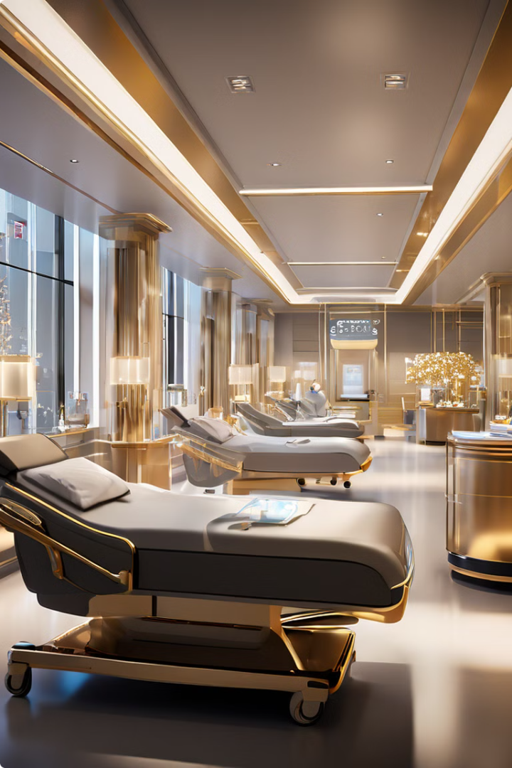
PROBLEM STATEMENT
INNOVATIVE MONITORING SYSTEM FOR TELEICU PATIENTS USING VIDEO PROCESSING AND DEEP LEARNING
~ BY TEAM DUELISTS

Slide 2
INDEX
UNIQUE SOLUTIONS
ADVANCE FEATURES
WORKFLOW
SYSTEM ARCHITECTURE
ARCHITECTURE DIAGRAM
DATASET GENERATION
USED TECHNOLOGIES
PERFORMANCE GRAPHS
MEET THE TEAM
CONCLUSION

Slide 3
UNIQUE SOLUTIONS
IT WILL DETECT & COUNT THE TYPE OF PERSON PRESENT IN THE ICU ROOM. HERE, WE ARE USING DEEP LEARNING NETWORK TO TRAIN THE MODEL FOR PREDICTION. NOW BASED ON PERSON PRESENT IN THE ROOM PRIORITY OF GENERATING ALARM & SYSTEM CONTINUITY WILL DIFFER.
WITH THE HELP OF THIS MODULE WE ARE DETECTING ANY TYPE OF MOTION HAPPENS IN THE ICU ROOM. HERE, SOME UNUSUAL MOTIONS ARE ALSO DETECTED SO WE PUT A ROI TO DETECT THE MOTION OF PATIENT. IF FALL IS DETECTED, WE PUT A THRESHOLD OF 3 SECOND TO GENERATE ALERT OF WHAT TYPE OF MOTION IS OCCURRED FOR WHICH WE USED FINE-TUNED YOLOV8 MODEL. FOR MOTION TYPE DETECTION LIKE HAND,HEAD,LEG AND BREATHLESSNESS WE USE SSIM MODULE.
WHEN PATIENT IS IN SOME PROBLEM ALERT IS GENERATED AND DISPLAYED .EVERY MOTION OF THE PATIENT IS HIGHLIGHTED WITH DIFFERENT BOUNDED BOX COLOURS.

Slide 4
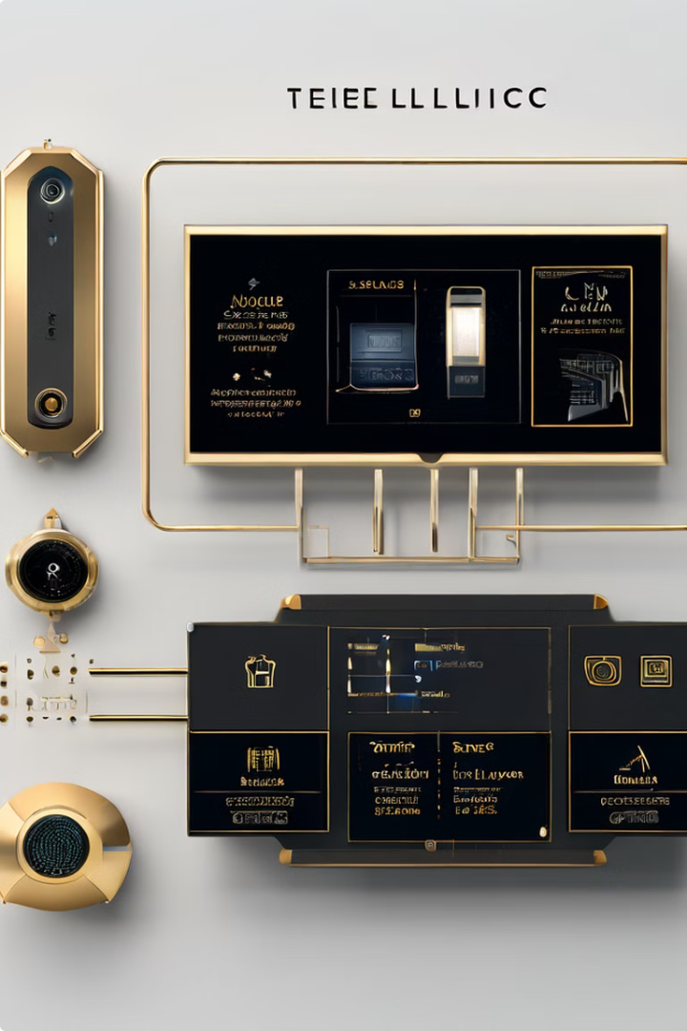
ADVANCED FEATURES
PATIENT ABNORMAL MOVEMENT DETECTION
DETECTS ALL THE UNUSUAL MOVEMENTS OF THE PATIENT SUCH AS FALL DETECTION. ALSO DETECTS WHETHER THE PATIENT IS HAVING PROBLEM TO BREATH OR ANYTHING LIKE THIS.
UTILIZING RESOURCES EFFECTIVELY
DETECTS IF THERE IS DOCTOR OR NURSE IN THE ICU ROOM USING OUR FINE-TUNED YOLO MODEL. IF YES, THEN IT STOPS DETECTING ABNORMAL MOVEMENTS OF THE PATIENT RESULTING IN LESS CONSUMING RESOURCE.

Slide 5
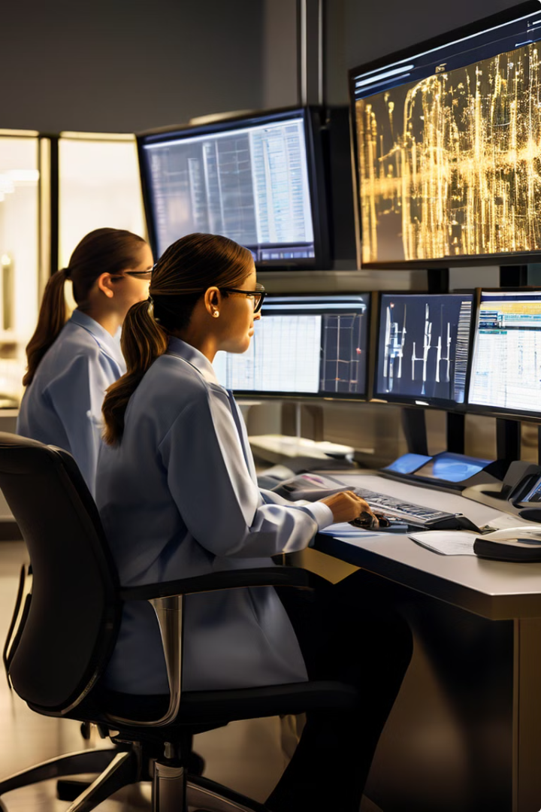
WORKFLOW
1
PERSON TYPE DETECTION
THIS MODULE IS STARTING POINT OF THE SYSTEM. IT WILL DETECT & COUNT THE TYPE OF PERSON PRESENT IN THE ICU ROOM. HERE, WE ARE USING DEEP LEARNING NETWORK TO FINE-TUNED THE MODEL FOR IDENTIFYING THE PERSONS PRESENT IN THE FRAME. NOW BASED ON PERSON PRESENT IN THE ROOM PRIORITY OF MONITORING THE PATIENT WHEN THERE ARE NO DOCTOR/NURSE .
2
MOTION DETECTION
WITH THE HELP OF SSIM MODULE WE ARE DETECTING ANY TYPE OF MOTION HAPPENS TO THE PATIENT. HERE, SOME UNUSUAL MOTIONS ARE ALSO DETECTED SO WE PUT A ROI TO DETECT THE MOTION OF PATIENT. AFTER MOTION IS DETECTED, WE PUT A THRESHOLD OF 3 SECOND TO GENERATE ALARM OF WHAT TYPE OF MOTION IS OCCURRED. FOR MOTION TYPE DETECTION WE WILL DEEP LEARNING.
3
EVENT HANDLERS
THIS MODULE IS MADE FOR HANDLING VARIOUS TYPE OF EVENTS HAPPENS IN THE SYSTEM. E.G. WHEN PATIENT IS IN SOME PROBLEM ALERT IS GENERATED AND DISPLAYED ,WHEN ANY TYPE OF SPECIFIC MOTIION DETECTED THE BOUNDED BOX COLOUR OF PATIENT CHANGE TO GREEN,YELLOW,BLUE,RED AND PUSH THE LOG FILE IN FOLDER.

Slide 6
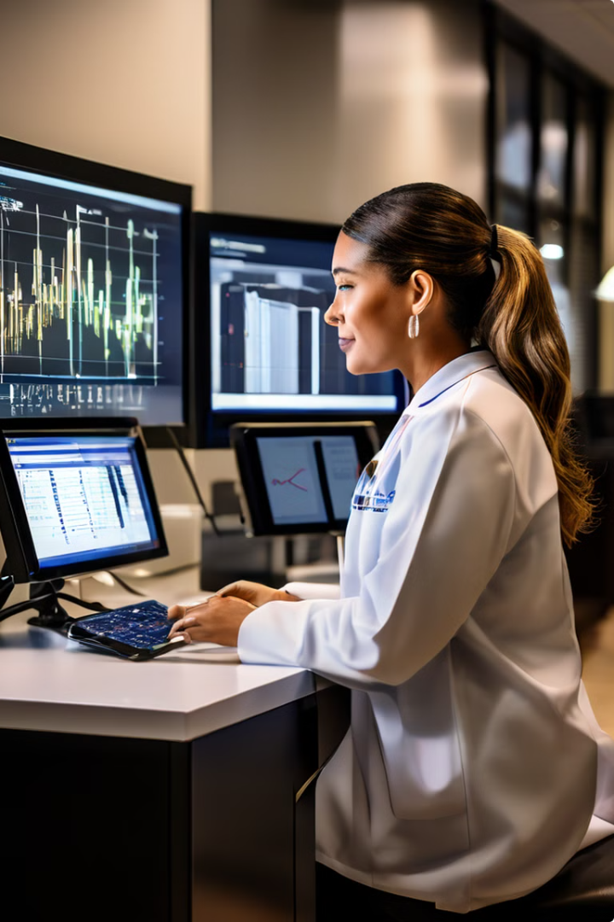
SYSTEM ARCHITECTURE
1
VIDEO CAPTURE
HIGH-RESOLUTION CAMERAS STRATEGICALLY PLACED THROUGHOUT THE ICU CAPTURE REAL-TIME VIDEO FOOTAGE OF THE ENVIRONMENT AND PATIENT ACTIVITIES.
2
AI-POWERED ANALYSIS
CUTTING-EDGE DEEP LEARNING ALGORITHMS, INCLUDING FINE-TUNED YOLOV8, ANALYZE THE VIDEO FEED TO DETECT AND CLASSIFY KEY ELEMENTS, SUCH AS DOCTORS, NURSES, PATIENTS, MONITORS AND OTHERS.
3
ALERT GENERATION
THE SYSTEM CONTINUOUSLY MONITORS THE ENVIRONMENT AND GENERATES CUSTOMIZED ALERTS WHEN IT DETECTS ANY ANOMALIES OR CRITICAL SITUATIONS OF PATIENT, ENABLING PROACTIVE INTERVENTION.
4
REMOTE ACCESS
HEALTHCARE PROVIDERS CAN ACCESS THE SYSTEM REMOTELY, ALLOWING THEM TO REVIEW PATIENT DATA, MONITOR VIDEO FEEDS, AND PROVIDE GUIDANCE TO THE ON-SITE CARE TEAM.

Slide 7
FOOTAGE INPUT
FRAMES
PRE-PROCESSING
PERSON TYPE DETECTION
if: type = ‘patient’
go_for_further_detection()
else: ignore the frame
Break the footage into frames
USING YOLOV8 MODEL
EITHER FROM CCTV
OR ANY MANUAL VIDEO FOOTAGE
Pre-process the frames
Here the model is customized and
specially trained for ICU environments
Go for detection
if: frame NOT contains [ ‘doctor’ OR ‘nurse’ ]
go_for_patient_movement_detection()
else: goto previous step
ARCHITECTURE DIAGRAM
FALL DETECTION BY GENERATING ALERT ON SCREEN
SPECIFIC MOVEMENTS IN RED BOUNDED BOX
PATIENT MOTIONS
SAVE LOG FILE AND OUTPUT VIDEO
ALERT CONTROL ROOM
PROCESSING UNUSUAL MOVEMENTS
PATIENT MOVEMENT DETECTION
Using YOLO V8 model
Here the model is customized and specially
trained for detecting patient movements

Slide 8
DATASET GENERATION
Collection of video data from various YouTube videos
Cleaning of Unwanted frames
Label Generation for supervised learning
Separation of test & train
Storing for model generation & reusing

Slide 9
ENABLING TECHNOLOGIES
COMPUTER VISION
DEEP LEARNING
CUTTING-EDGE COMPUTER VISION ALGORITHMS, INCLUDING OBJECT DETECTION AND CLASSIFICATION, ENABLE THE SYSTEM TO ACCURATELY IDENTIFY AND TRACK KEY ELEMENTS WITHIN THE ICU ENVIRONMENT.
THE SYSTEM LEVERAGES ADVANCED DEEP LEARNING MODELS, SUCH AS YOLOV8, TO ANALYZE VIDEO FOOTAGE AND DETECT ANOMALIES OR CRITICAL SITUATIONS IN REAL-TIME, FACILITATING PROACTIVE INTERVENTION.

Slide 10
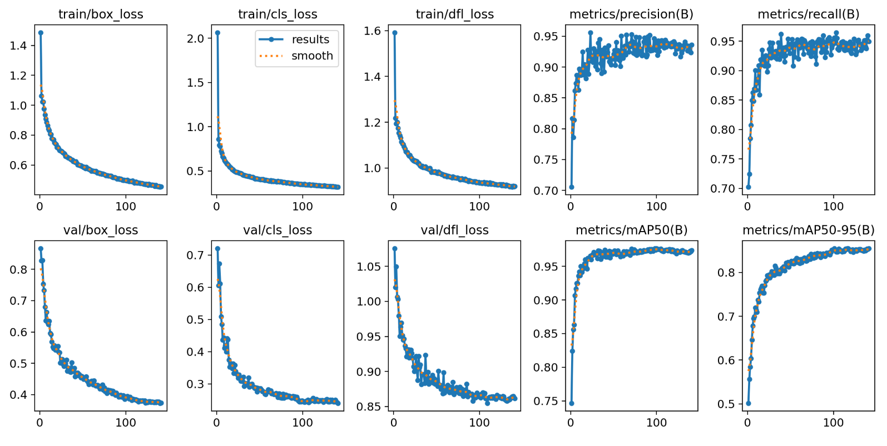
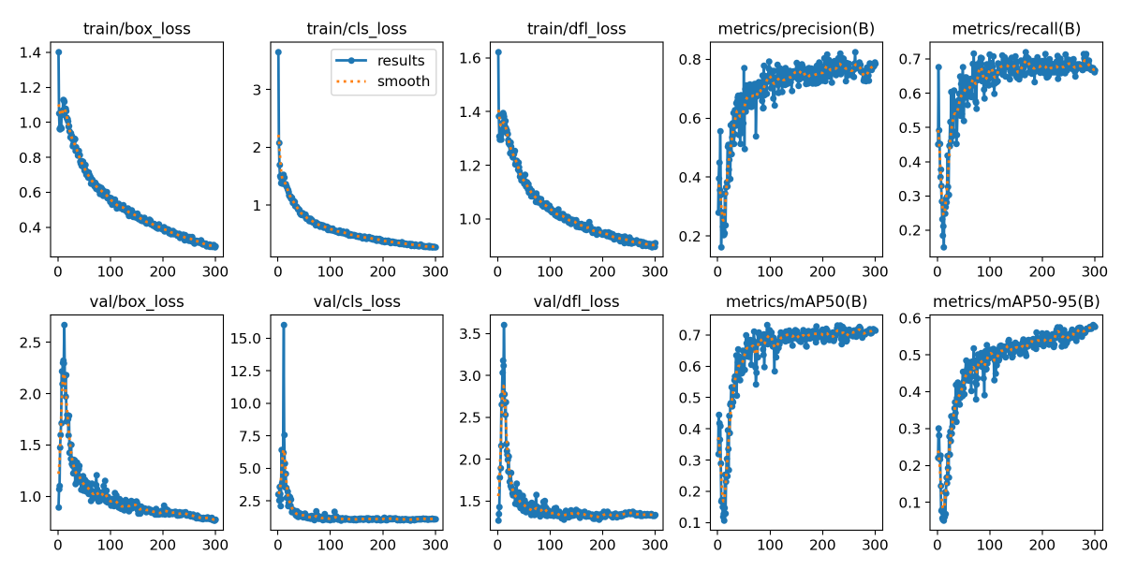
PERFORMANCE MATRICES & GRAPHS
person_labelling
Fall_detection

Slide 11
MEET THE TEAM DUELISTS
DEBRAJ MISTRY (TEAM LEAD)
MODEL TRAIN, TEST AND CODER
MD FAIZAN
MODEL TRAIN, TEST AND CODER
JYOTIPRIYA MALLICK
DATA COLLECTION AND DATASET DESIGN
SUSHANTA BHUNIA
DATA COLLECTION AND DATASET DESIGN

Slide 12
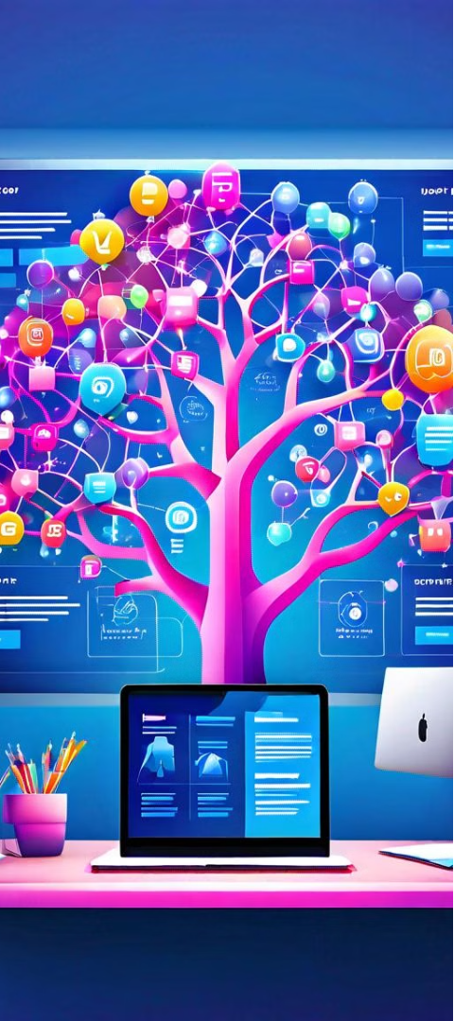
CONCLUSION
ENHANCE PATIENT SAFETY
THE TELEICU MONITORING SYSTEM'S ABILITY TO DETECT ANOMALIES AND CRITICAL SITUATIONS IN REAL-TIME EMPOWERS HEALTHCARE PROVIDERS TO RESPOND QUICKLY, ULTIMATELY IMPROVING PATIENT SAFETY AND REDUCING THE RISK OF ADVERSE EVENTS.
OPTIMIZE RESOURCE UTILIZATION
BY PROVIDING VALUABLE INSIGHTS AND DATA-DRIVEN RECOMMENDATIONS, THE SYSTEM HELPS HEALTHCARE ORGANIZATIONS OPTIMIZE THE ALLOCATION OF MEDICAL RESOURCES, ENSURING THAT PATIENTS RECEIVE THE RIGHT CARE AT THE RIGHT TIME.
IMPROVE CARE OUTCOMES
THE SEAMLESS INTEGRATION OF THE TELEICU MONITORING SYSTEM WITH HOSPITAL INFRASTRUCTURE AND THE ABILITY TO PROVIDE REMOTE GUIDANCE TO THE CARE TEAM CONTRIBUTE TO BETTER PATIENT OUTCOMES AND MORE EFFICIENT HEALTHCARE DELIVERY.

Slide 13
Thank You

