Slide 1
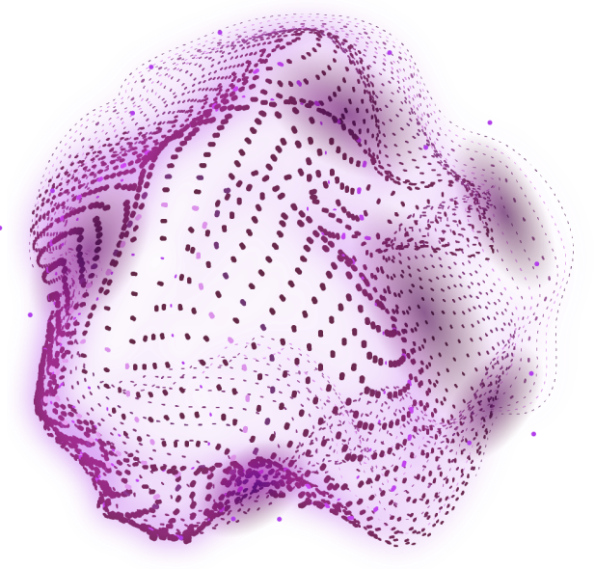
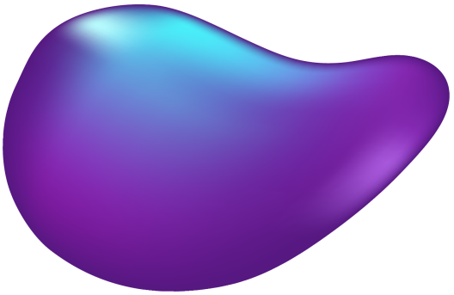

Optimizing Chest X-Ray diagnostics :
“Knowledge Distillation for Efficient Multi-Class Classification with Semi-Supervised Segmentation”

Slide 2
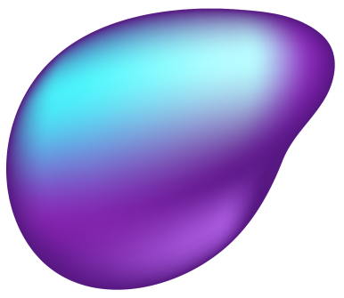


OUR TEAM
Mohammed Nahid Hossain
ID: 2011964042
Tashfia Kashem Chowdhury
ID: 2022286642
Mohammod Abdullah Bin Hossain
ID: 2022351642
Ristian Uddin
ID: 2021188042

Slide 3
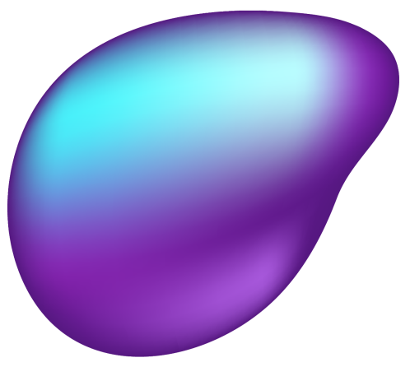
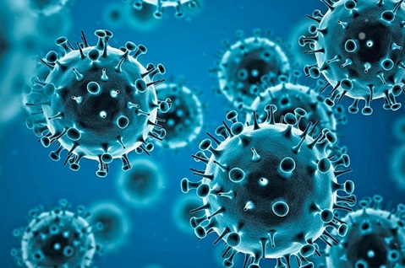
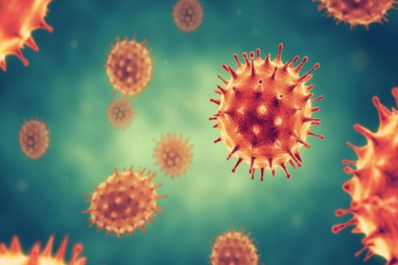
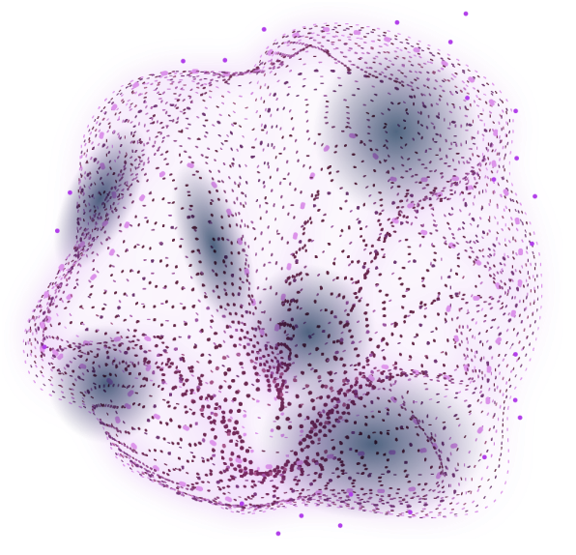

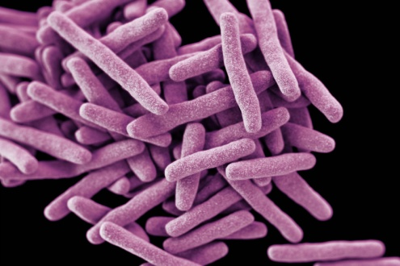

INTRODUCTION
COVID-19
Viral respiratory illness caused by SARS-CoV-2.
Symptoms include fever, cough, and difficulty breathing.
Can lead to severe respiratory complications and death.
PNEUMONIA
Inflammation of the air sacs in the lungs.
Often caused by bacterial or viral infections.
Symptoms include fever, chills, chest pain during breathing.
TUBERCULOSIS
Infectious disease caused by Mycobacterium tuberculosis bacteria.
Primarily affects the lungs but can affect other parts of body.
Symptoms include persistent cough, weight loss, night sweats.

Slide 4
Related works
"A thorough review of the classification of non-small cell lung cancer (NSCLC) utilizing deep learning and knowledge distillation"
Deep Learning: CNNs (ResNet, DenseNet) excel in NSCLC subtype classification.
Transfer Learning: Pre-trained models (e.g. ResNet, VGG) fine-tuned on NSCLC data.
Knowledge Distillation: Compresses complex "teacher" models into efficient "student" models for real-world use.
Multi-Modal Learning: Combines imaging and pathology for better accuracy.
Challenges: Data scarcity and interpretability issues.
Datasets: Public datasets like LIDC-IDRI and TCIA used for training and validation.
Result : With optimized hyperparameters(alpha = 0.7 and temperature = 7),the TA and Student networks obtain the highest accuracies of 90.99% and 94.53% respectively.
Future: Focus on distillation and interpretability.

Slide 5
Dataset Acknowledgement
Gratitude to NIDCH(National Institute of Diseases of the Chest and Hospital):
Special thanks to NIDCH Hospital Authority for providing 37 X-ray images
Thanks to Dr. Fahima Kashem Chowdhury for helping us with the annotation of these images (25
NIAID Tb Dataset:
We sincerely thank NIAID(National Institute of Allergy and Infectious Diseases) for providing valuable TB datasets accessible online, which greatly supported our research efforts.
Openly Available Dataset:
We also collected datasets from Mendeley for hosting diverse and high-quality datasets, which significantly enriched our research.
These contributions were crucial for our research and development.

Slide 6
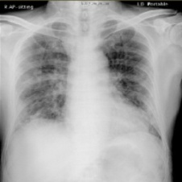
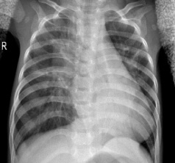
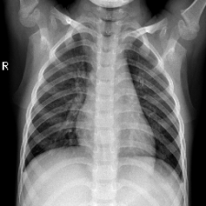
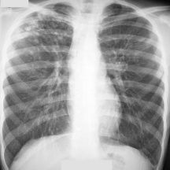
Dataset
Covid- 3214, Pneumonia- 4110 & Normal- 4115 [1] [2]
Tuberculosis -4053 [3]
MERGED

Slide 7
AUGMENTATION

Slide 8

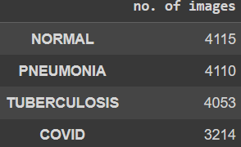
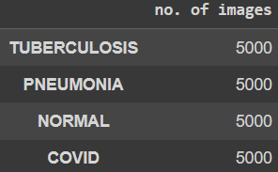
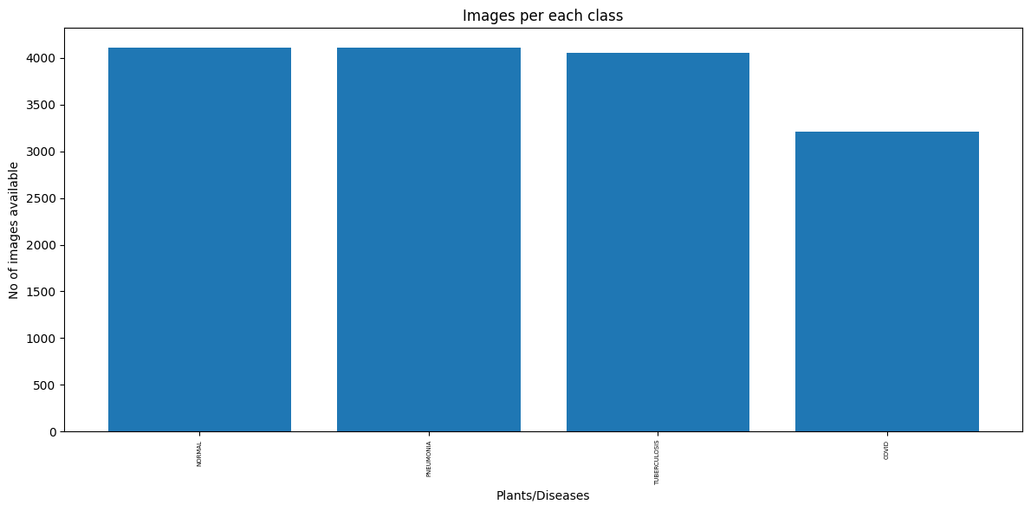
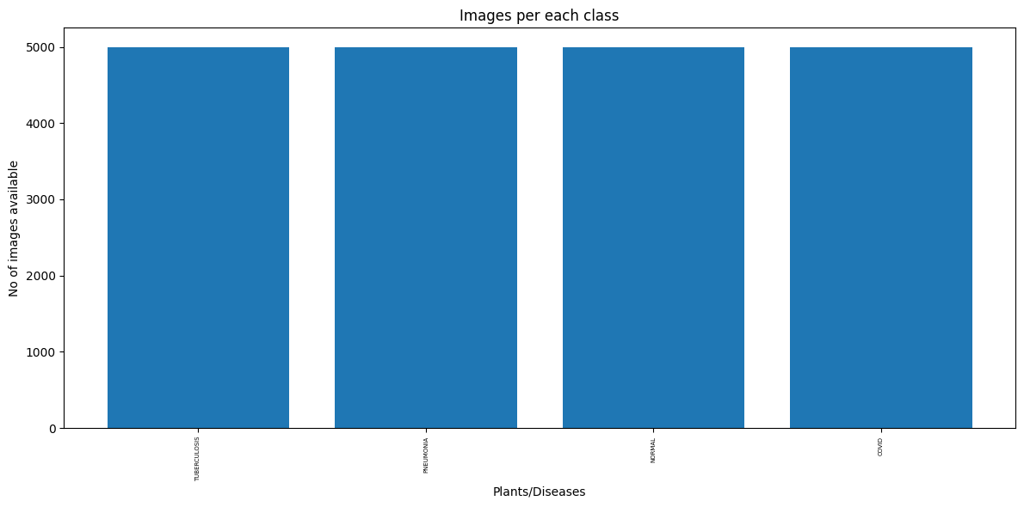
DATASET AUGMENTATION
Synthetic Samples added changing Hyperparameters like: height, width, zoom in & out, rotation, horizontal flip etc.
BEFORE | AFTER

Slide 9
Segmentation

Slide 10
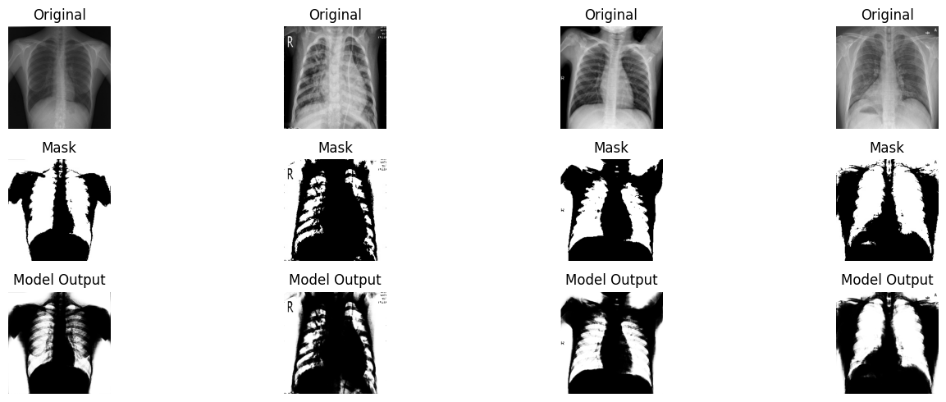
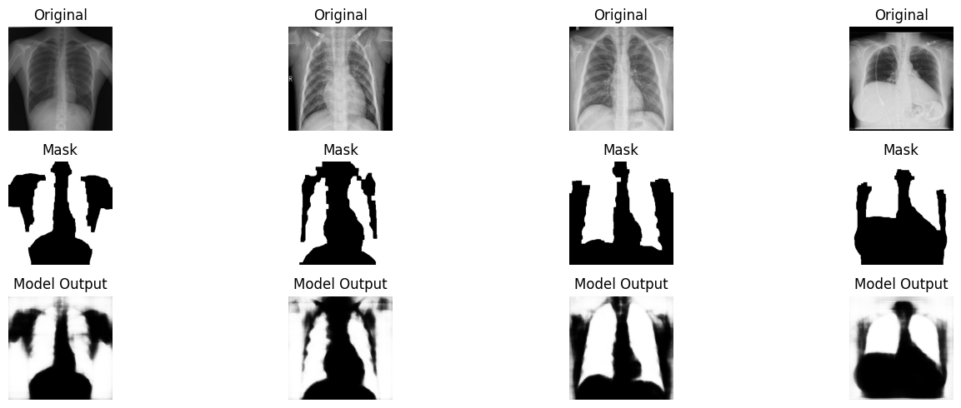
THRESHOLD BASED SEGMENATION
Segmentation techniques using u-net
CONTOUR BASED SEGMENATION

Slide 11
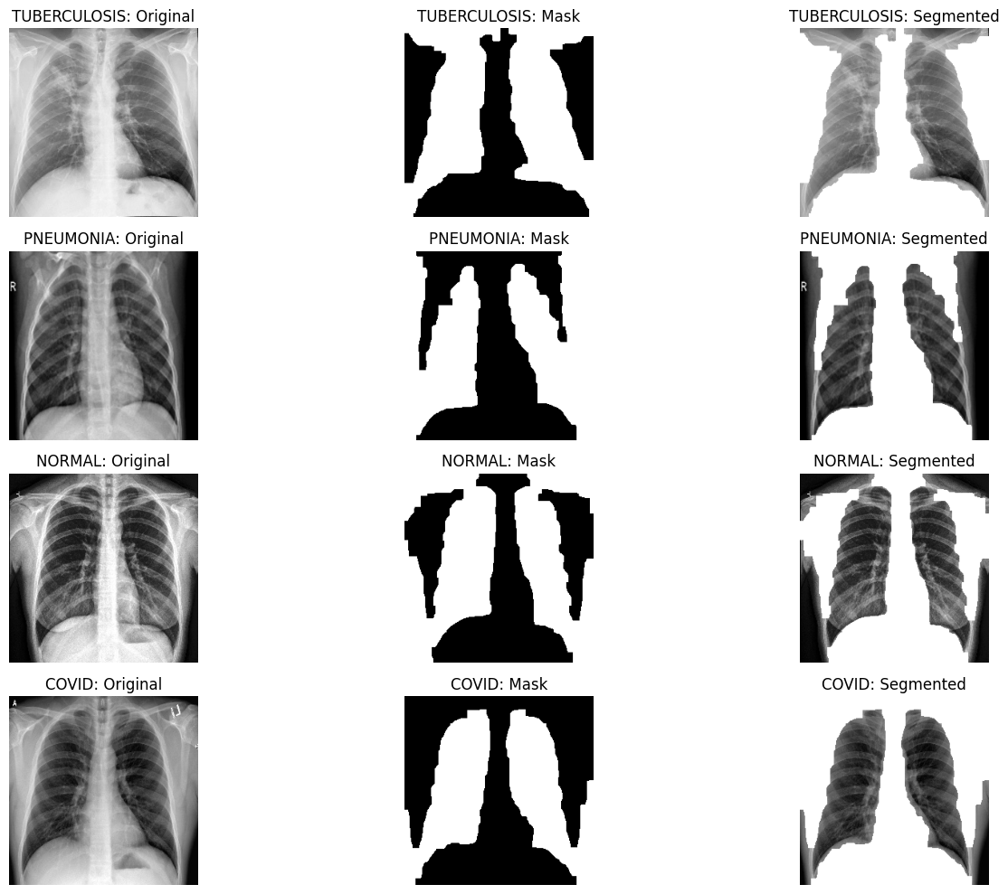
Segmented images generated from contour based segmentation

Slide 12
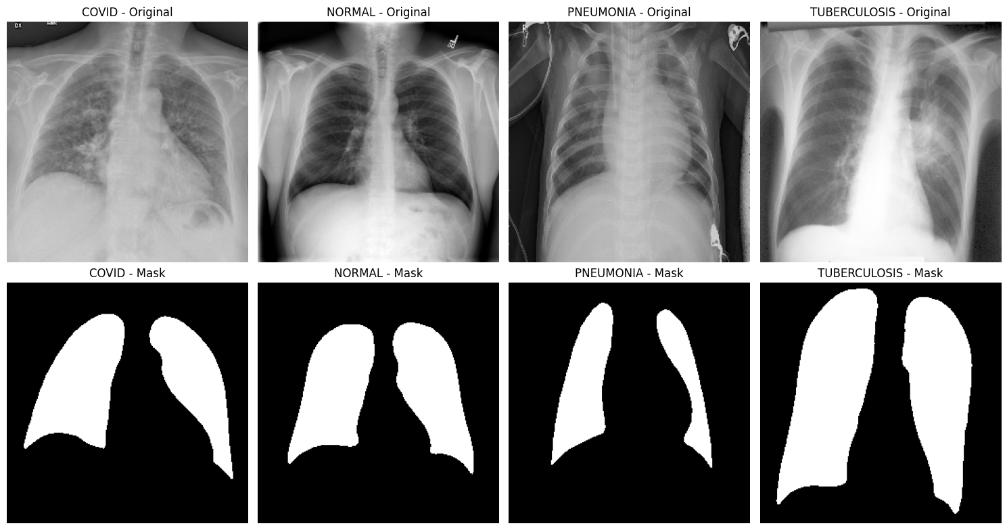
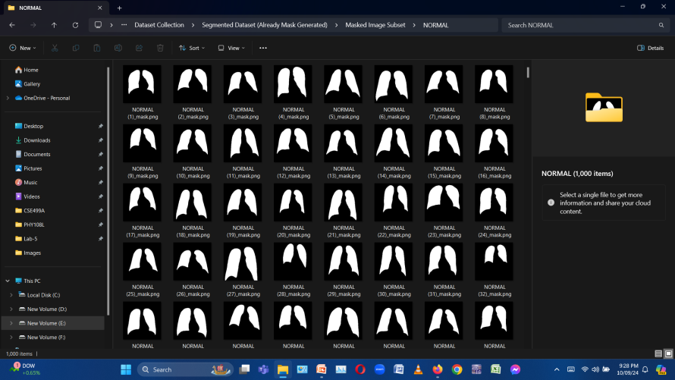
Segmentation techniques using u-net
Semi-Supervised Segmentation
Original Dataset: normal:1000; covid:1000; pneumonia:1000 = 3000
manual mask Dataset: normal:1000; covid:1000; pneumonia:1000 = 3000 [4]

Slide 13
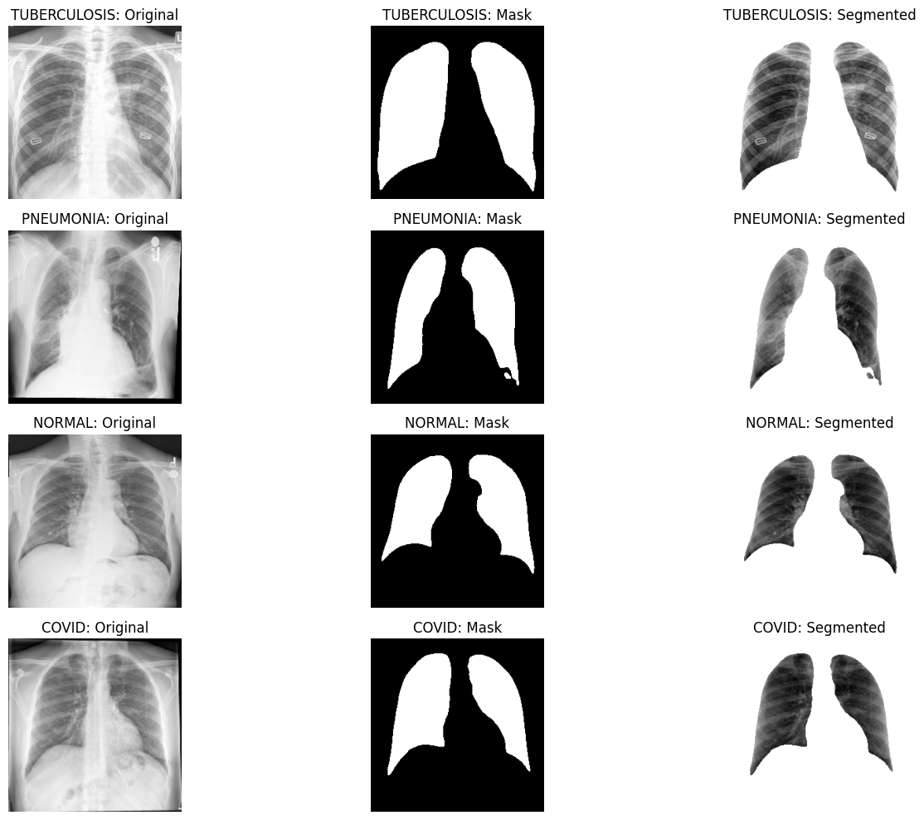
Segmented images generated from Semi-supervised segmentation

Slide 14
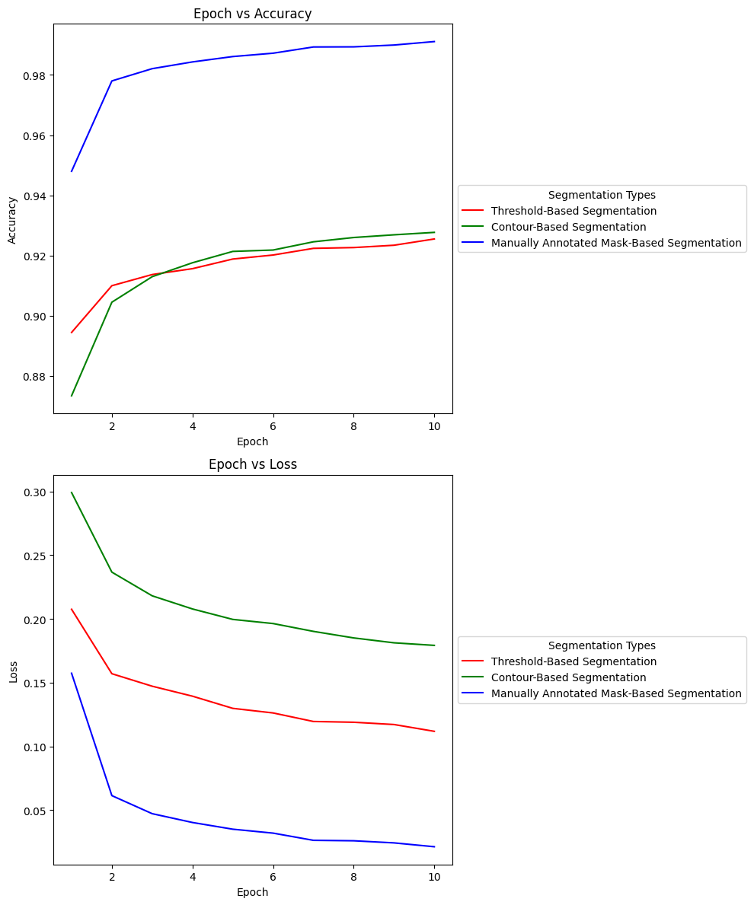
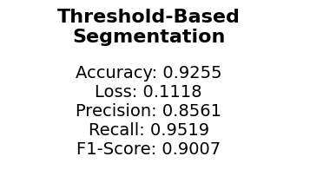
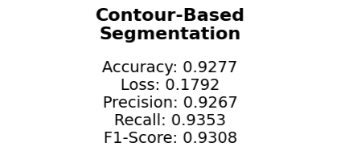
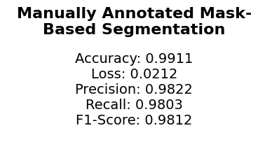
ACCURACY & LOSS SCORES OF ALL SEGMENTATION TECHNIQUES
f
Semi supervised Segmentation

Slide 15
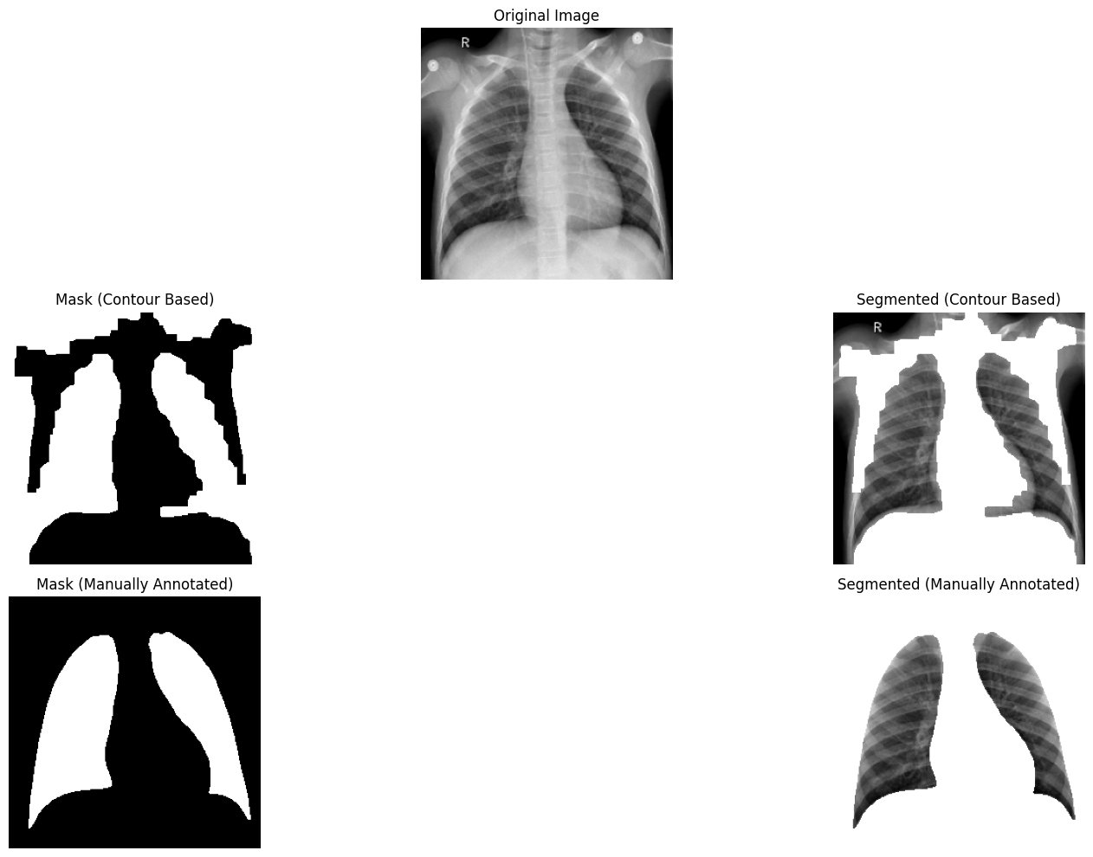
Side by side comparison of all segmentation techniques

Slide 16
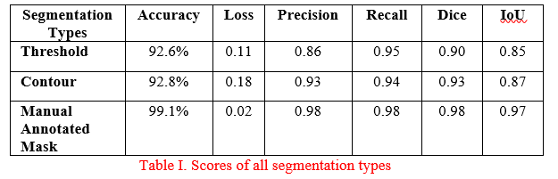
Segmentation Scores

Slide 17
CNN Models
(on original & segmented Images)

Slide 18
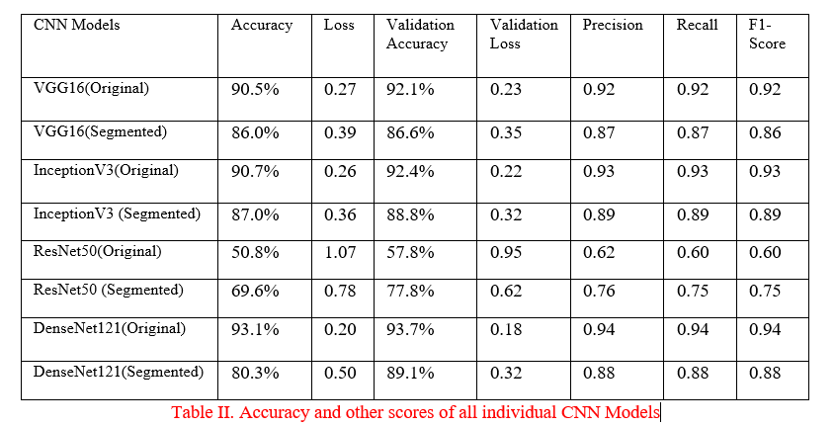
Evaluation Metrics

Slide 19
Attention Mechanism

Slide 20
Attention Mechanism
Attention mechanism can be applied to enhance the model's performance by allowing the network to focus on the most informative features in the image
Improves the model’s ability to distinguish important features in the image

Slide 21
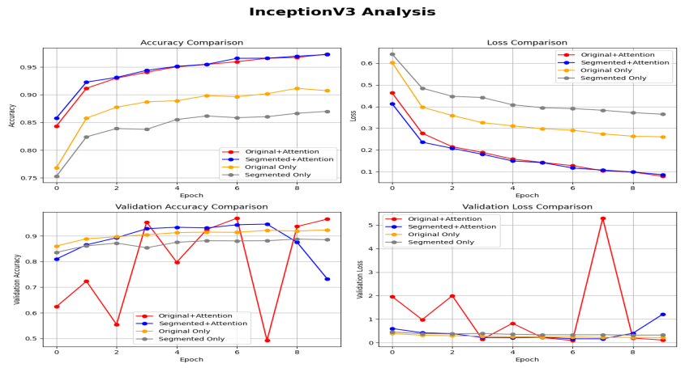
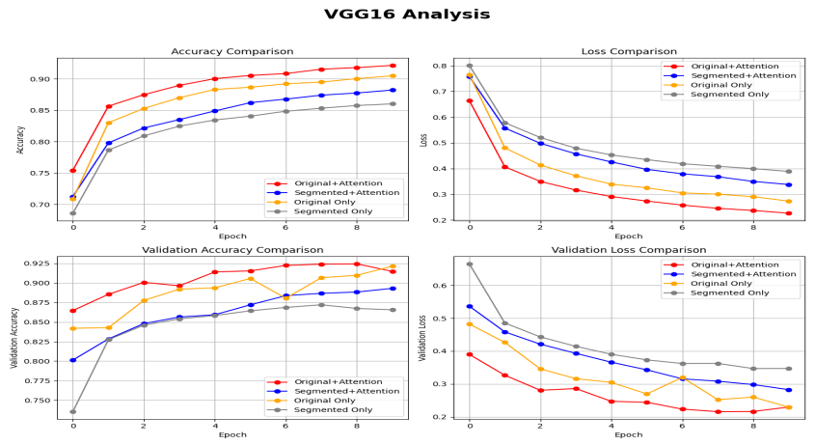
Evaluation Graphs

Slide 22
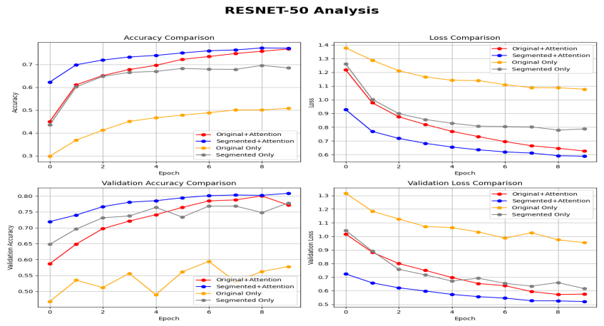
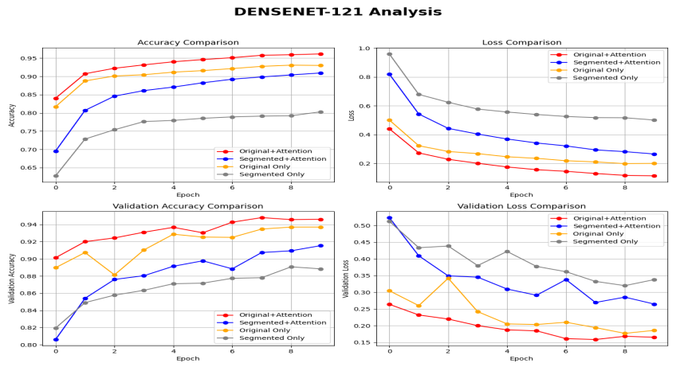
Evaluation Graphs

Slide 23
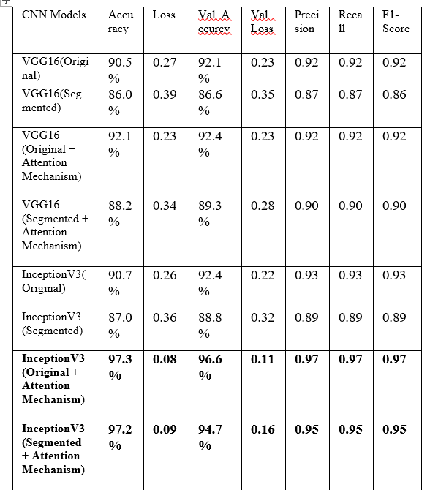
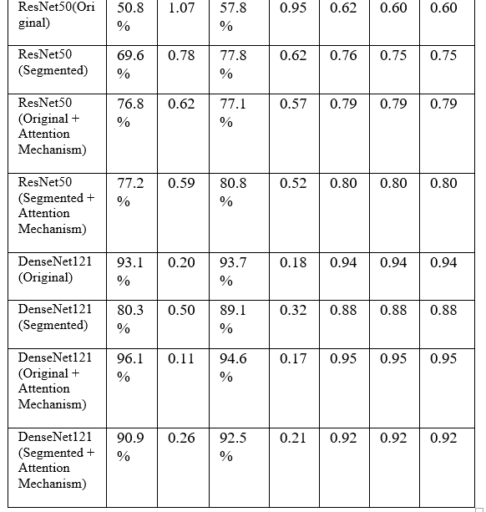

Slide 24
Ensemble Models

Slide 25
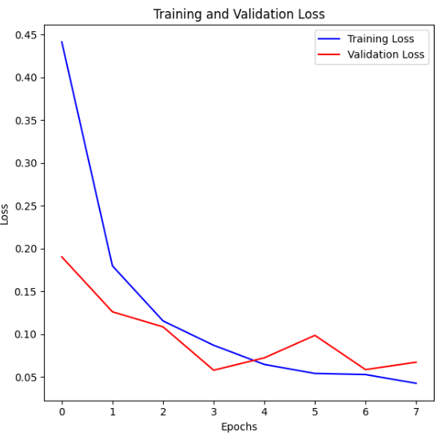
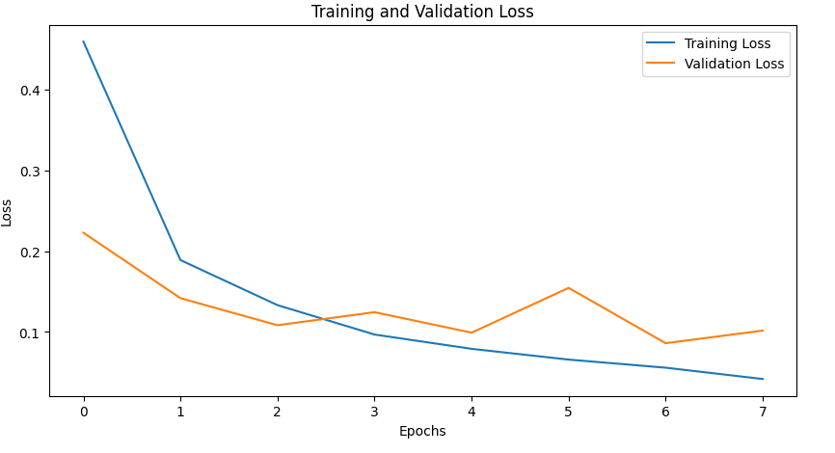


EfficientNet-B2 + ResNet-50
Original Image Segmented Image

Slide 26
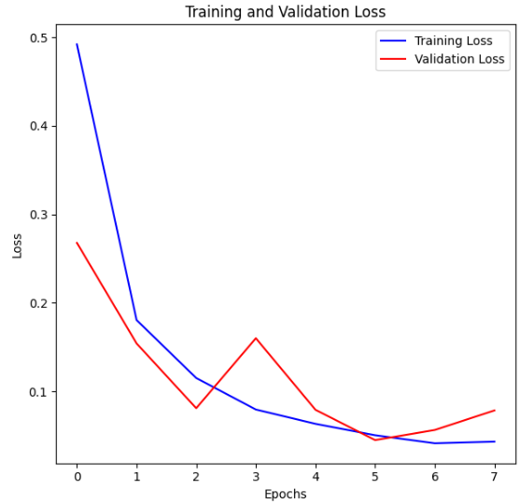
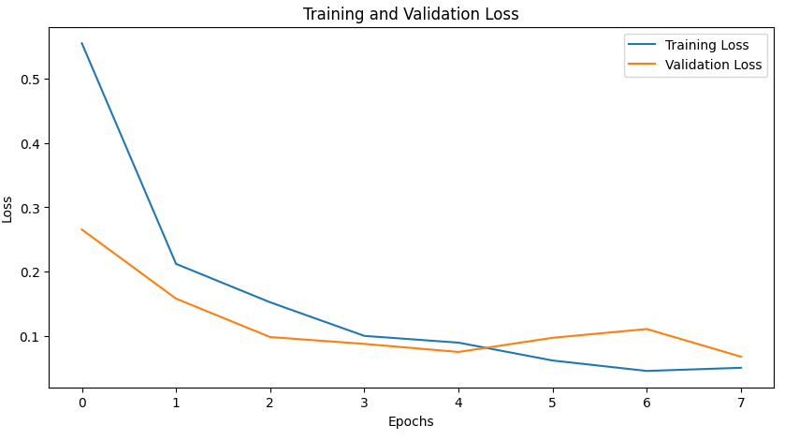


EfficientNet-B2 & DenseNet-121
Original Image Segmented Image

Slide 27
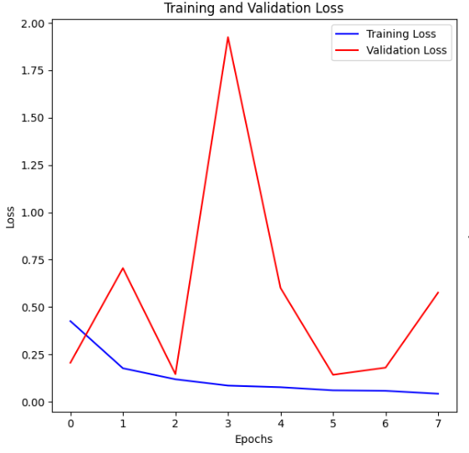
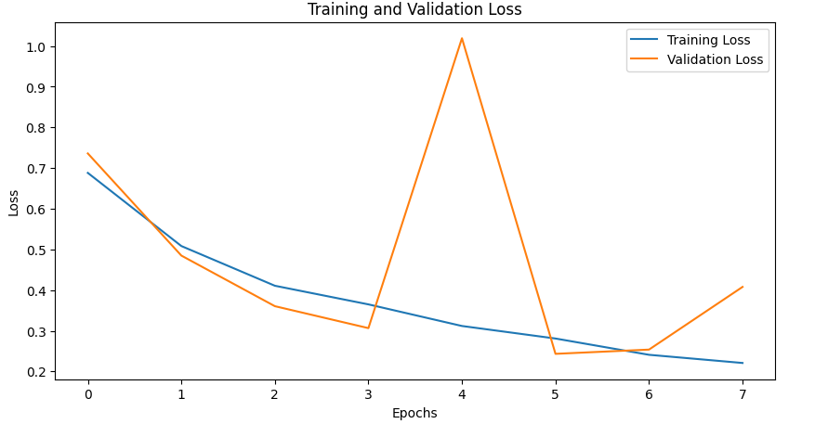


VGG-16 & DenseNet-121
Original Image Segmented Image

Slide 28
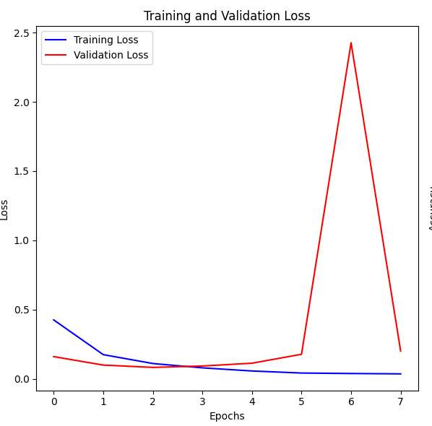
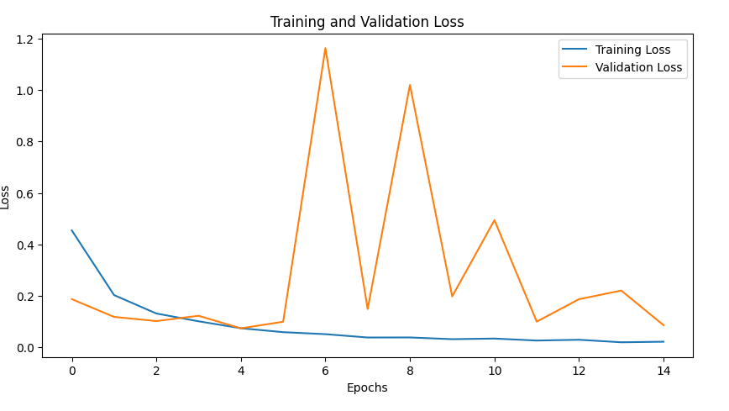


VGG-16 & EfficientNet-B2
Original Image Segmented Image

Slide 29
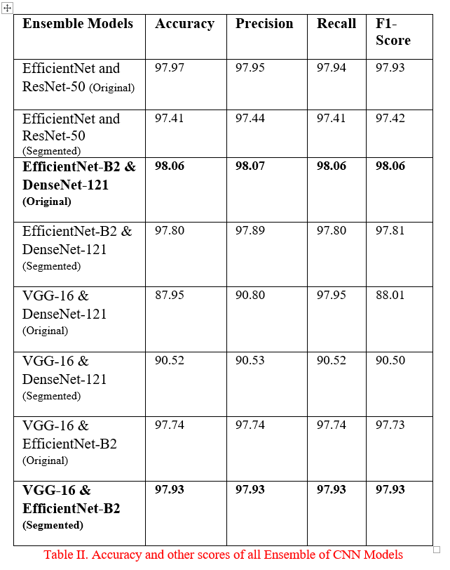
Evaluation Metrics

Slide 30
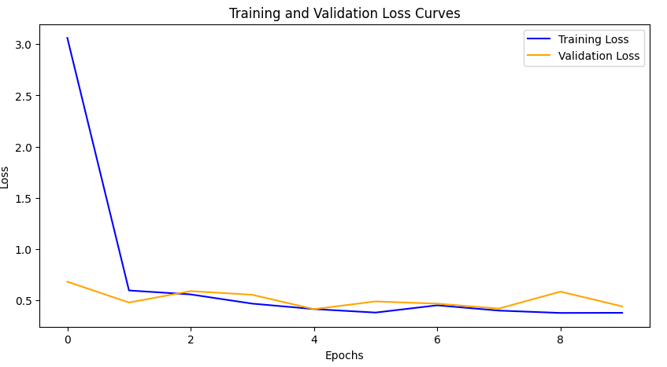

Vision transformer

Slide 31
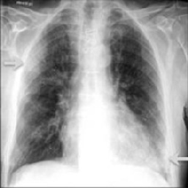
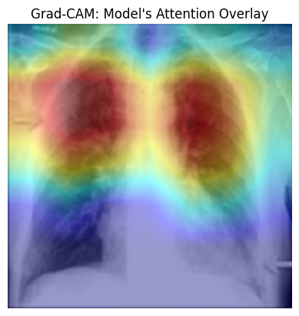
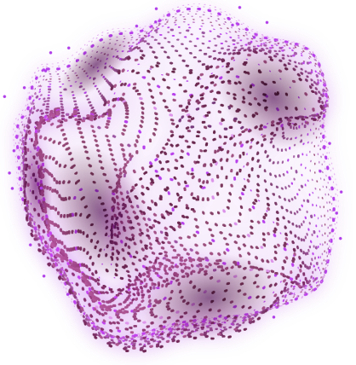



Grad cam and Inference
Original Image
Grad cam

Slide 32
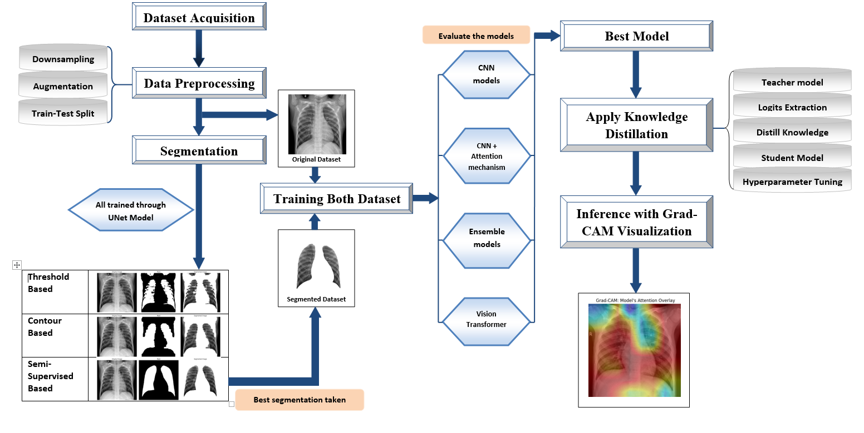
SYSTEM DESIGN

Slide 33
Mathematics Behind iterations
Dataset Size (N): 20000
Batch Size (B): 32
Iterations per Epoch: N/B = 14000/32 = 650
Number of iterations = Epochs * Iterations per Epoch = 8*650 = 5000 iterations
One iteration = one forward pass and one backward pass for a batch of data.
Each iteration updates the model's weights based on the loss calculated from the batch it processed.

Slide 34
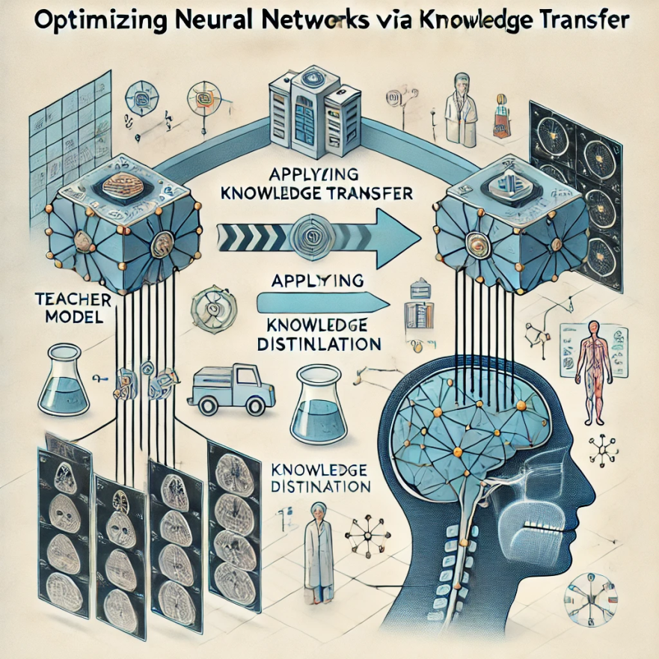
Optimizing Neural Networks via Knowledge Transfer: Applying Knowledge Distillation

Slide 35




Introduction to Knowledge Distillation
A method where a large, well-trained model (teacher) transfers its knowledge to a smaller model (student).
Purpose: Compresses complex models while maintaining accuracy.
Mechanism: The student model learns from both the teacher's soft predictions and
the actual hard labels.
Improve Efficiency: Reduce computational resources required for inference, enabling deployment on devices with limited capacity (e.g., mobile devices, edge computing).
Maintain Performance: Ensure that the smaller model retains accuracy and generalization capabilities similar to the larger model.

Slide 36

Diagram of applying knowledge distillation technique

Slide 37

Teacher Model Vs Student Model
Specifications | Teacher model | Student Model
Model | Custom ViT | MobileNetV2 (Pre-trained)
Convolutional Layers | 82 | 35
Trainable parameters | 51,014,251 (51.14 Million) | 2,025,924 (2.25Million)
Size | 194.60 MB | 9.24 MB
Computational time | 6400 s | ~ 1750 s

Slide 38
Result Analysis on teacher and student model
Result Specification | Teacher Model | Student Model
Model | Custom ViT | MobileNet V2 (Pre-trained)
Training Accuracy | 0.90 | 0.99
Training Loss | 0.30 | 0.08
Validation Accuracy | 0.89 | 0.97
Validation Loss | 0.29 | 0.08
Testing Accuracy | 0.90 | 0.97
Testing Loss | 0.28 | 0.08

Slide 39


Training and Validation for both teacher and student model
Teacher model
Student model
* These graphs represent the accuracies and losses of training and validation set
for both teacher and student model

Slide 40
Result Analysis on both teacher and student
Teacher Model | Student Model
Precision | Recall | F1 Score | Precision | Recall | F1 Score
COVID | 0.88 | 0.91 | 0.90 | 0.99 | 0.97 | 0.98
NORMAL | 0.88 | 0.87 | 0.87 | 0.98 | 0.95 | 0.95
PNEUMONIA | 0.96 | 0.90 | 0.93 | 0.95 | 0.97 | 0.96
TUBERCULOSIS | 0.89 | 0.92 | 0.91 | 0.98 | 0.99 | 0.98
Accuracy | 0.90 | 0.99

Slide 41


Training and Validation for both teacher and student model
Teacher model
Student model
* These graphs represent the accuracies and losses of training and validation set
for both teacher and student model

Slide 42
Discussion on Knowledge Distillation for both datasets
* Achieved the primary objective of knowledge distillation, where the lightweight student
the model successfully learned from the teacher model and outperformed it.

Slide 43

Real-time Web Application

Slide 44



Slide 45
Pioneering the Future
Enhance User Interface (UI) Design
Integrate Segmented Image Dataset more to the project
Expand Dataset Diversity
Collect Real-Time Datasets

Slide 46

Distinctive Evaluation of Our Project

Slide 47
Thank you.

Slide 48
REFERENCES
  [1] https://data.mendeley.com/datasets/mxc6vb7svm/2
  [2] https://data.mendeley.com/datasets/jctsfj2sfn/1
  [3] HTTPS://TBPORTALS.NIAID.NIH.GOV/
  [4] Chowdhury, M.E.H.; Rahman, T.; Khandakar, A. COVID-19 Radiography Database. 2021. Available online: https://www.kaggle.com/datasets/tawsifurrahman/covid19-radiography-database (accessed on 1 October 2021).
  [5] N.; Sharma, N.; Saba, L.; Khanna, N.N.; Kalra, M.K.; Fouda, M.M.; Suri, J.S. Segmentation-Based Classification Deep Learning Model Embedded with Explainable AI for COVID-19 Detection in Chest X-ray Scans. Diagnostics 2022, 12, 2132.https://doi.org/10.3390/diagnostics12092132
  [6] Rahman, T. Tuberculosis (TB) Chest X-ray Database. 2021. Available online: https://www.kaggle.com/tawsifurrahman/tuberculosis-tb-chestxray-dataset (accessed on 1 October 2021).
  [7] Mooney, P. Cest X-ray Images (Pneumonia). 2021. Available online: https://www.kaggle.com/datasets/paultimothymooney/chest-xray-pneumonia (accessed on 1 October 2021).
  [8] Chowdhury, M.E.H.; Rahman, T.; Khandakar, A.; Mazhar, R.; Kadir, M.A.; Bin Mahbub, Z.; Islam, K.R.; Khan, M.S.; Iqbal, A.; Al Emadi, N.; et al. Can AI Help in Screening Viral and COVID-19 Pneumonia? IEEE Access 2020, 8, 132665–132676. [CrossRef]
  [9] Pandey, N. Chest X-ray Masks and Labels. 2022. Available online: https://www.kaggle.com/datasets/nikhilpandey360/chest-xray-masks-and-labels (accessed on 8 January 2022).

