Slide 1
Machine Learning approach for Predicting Breast Cancer using Genomic Data
Authors: Saurabh Sharma, Rishiraj Singh, Neel Shah, Reena Lokare
Affiliation: KJ Somaiya Institute of Engg & I.T., Mumbai University, Department of I.T., India

Slide 2
Introduction
Current Major challenge -
Predicting disease w/ high accuracy.
Earliest stage.
Prediction using clinical data only
Proposed system -
Prediction using genomic expression.
Prediction of risk of Breast Cancer.
No clinical data used.

Slide 3
Research Question
To investigate the potential of Gene expression profiles in predicting the risk of breast cancer using machine learning algorithms.

Slide 4
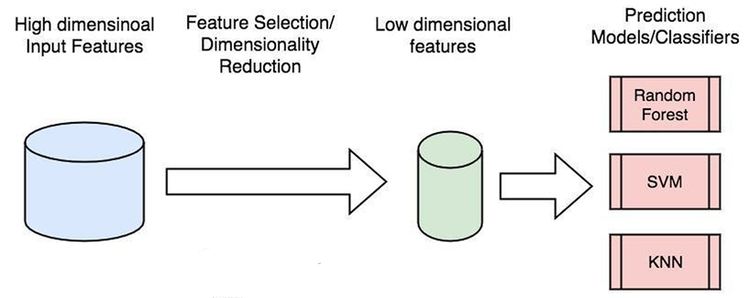
Methodology
The methodology of the proposed model is divided into four phases

Slide 5
Models and Techniques
We have built 2 models using 4 supervised machine learning algorithms namely:
SVM
Decision Tree
Naive bayes
KNN

Slide 6
Experimental Setting
All 4 algorithms were applied on same preprocessed dataset.
Dataset consists of patient code and the gene expression values of their 22 selected genes.
The Gene values of the patients were obtained using MicroArray.
All the algorithms implemented in Python 3.15 using sklearn python module.

Slide 7
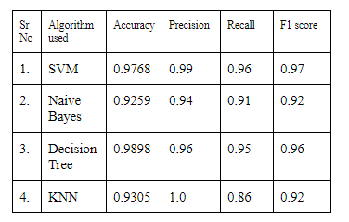
Results and Discussion
Table - Performance Comparison of ML algorithms

Slide 8
Conclusions and Future Research
Cancer prognosis is possible
Using Machine Learning
On high dimensional Genomic data
Conventional cancer prediction
No risk prediction.
It can be done using Genomic data.
For better prediction -
Combined genomic and clinical data required.

Slide 9
References
National Center for Biotechnology Information. Accessed on: Feb 13, 2020. Available: https://www.ncbi.nlm.nih.gov/guide/genes-expression
Breastcancer.org. Accesses on: Feb 13, 2020. Available: https://www.breastcancer.org/risk/factors/genetics.
https://www.mun.ca/biology/scarr/cDNA_microarray_Assay_of_Gene_Expression.html

Slide 10
Appendices
For detailed information on the 22 selected genes[2].
The detailed information on collecting Gene data which is used here can be found at [3].

